Slide 1
Weighting predators by temperature and prey

Slide 2
Motivation
Preponderance of negative coefficients on prey terms and positive coefficients on predators
Minimal interannual variation in predator time series led to poor performance compared to negative prey indices
Lack of any management implications for future work

Slide 3
SHARKS
known significant salmon predators Seitz et al. (2019) Mechanism:
Spatial overlap w/ salmon may increase in warm years
Salmon could go deeper earlier, reside in narrower band of water
Langan et al 2024
Shark consumption in general might increase in warm years: metabolic cost increases hunger, eat more salmon
Carlson et al. (2004), Goldman et al. (2004)
Notes:
Here are strong academic references organized directly by your three methodological needs:
1. Sharks as Key Predators on Salmon (Specifically Chinook)
Seitz et al. (2019) remains the defining empirical tag-recovery study demonstrating that salmon sharks (Lamna ditropis) are the dominant predator on large ocean-stage Chinook salmon in the GOA/Bering Sea.
Ohlberger et al. (2018): Demographic changes in Pacific salmon induced by marine competition and predation. (PNAS, 115(21), 5389-5396).
Use for: Documenting that marine predation is a primary top-down driver of decreasing Chinook salmon size and age structure across the North Pacific.
Chasco et al. (2017): Competing claims for Pacific salmon by marine mammals and fisheries. (Scientific Reports, 7, 10980).
Use for: Highlighting the broader context of top-down consumption dynamics on Chinook salmon during their marine life history phase.
2. Chinook Salmon Ocean Distributions Track Thermal Preference
Langan et al. (2024): Opening the black box: New insights into the role of temperature in the marine distributions of Pacific salmon. (Fish and Fisheries, 25(4), 551-568).
Use for: The most up-to-date and comprehensive evidence that Chinook salmon marine distributions actively track species-specific thermal ranges and preferred SST envelopes across the North Pacific.
Hunsicker et al. (2022): Elucidating climate displacement of marine species across regional spatial scales. (Global Change Biology).
Use for: Supporting the spatial overlap hypothesis—showing how thermal shifts in the Gulf of Alaska compress or expand the spatial overlap between pelagic predators and salmon prey.
3. Salmon Shark Endothermy & Temperature-Driven Metabolic Rates
Bernal et al. (2005): Mammal-like muscles power swimming in a cold-water shark. (Nature, 437, 1349–1352).
Use for: Proof of lamnid metabolic specialization. Demonstrates that salmon shark aerobic swimming muscles function optimally only at elevated internal temperatures ($20^\circ\text{C}$–$30^\circ\text{C}$).
Carlson et al. (2004): Metabolic rate and energetics of lamnid sharks. (Special Publication of the American Fisheries Society).
Use for: Standard metabolic rate scaling equations for lamnids, proving standard metabolic rate increases with ambient water temperature.
Goldman et al. (2004): Homeothermy and thermoregulation in the salmon shark, Lamna ditropis. (Journal of Comparative Physiology B).
Use for: Direct physiological evidence that salmon sharks actively thermoregulate and maintain visceral/body temperatures up to $15^\circ\text{C}$–$20^\circ\text{C}$ above ambient water, elevating their total daily energetic requirements in warm water.
References
Bernal, D., Donley, J. M., Shadwick, R. E., & Syme, D. A. (2005). Mammal-like muscles power swimming in a cold-water shark. Nature, 437(7063), 1349–1352. https://doi.org/10.1038/nature04007
Cited by: 131

Slide 4
SSL in GOA
known to prey-switch to target salmon seasonally and when other prey are less available Mechanism:
3. Prey-Switching to Salmon when Lipid-Dense Forage Fish (herring, capelin) Decline Fritz et al. (2019), McHuron et al. (2018), Lander et al. (2020)
(also 2) Consumption in general might increase in warm years: have to forage further offshore, dive deeper, longer, more costly trips when coastal prey less available, increases metabolic cost, eat more salmon Sigler et al. (2009), Womble and Sigler (2006), Trites and Donnelly (2003)
Notes:
These published, peer-reviewed citations defend Steller sea lion (Eumetopias jubatus) prey-switching dynamics and warm-water foraging/metabolic impacts across the Gulf of Alaska (GOA) and Columbia River (CR).
1. Prey-Switching to Salmon when Lipid-Dense Forage Fish Decline
Gulf of Alaska (Switching from Herring/Capelin)
Sigler et al. (2009): Availability and consumption of forage fish in relation to Steller sea lion abundance. (Marine Ecology Progress Series, 388, 243–261).
Use for: Direct empirical evidence that Steller sea lions act as opportunistic predators that rapidly shift their diet toward Pacific salmon (Oncorhynchus spp.) when aggregations of high-energy lipid forage fish like Pacific herring (Clupea pallasii) and capelin (Mallotus villosus) decrease or disperse seasonally/spatially.
Womble and Sigler (2006): Seasonal availability of abundant, energy-dense prey influences the abundance and diet of a marine predator, the Steller sea lion. (Marine Ecology Progress Series, 325, 281–293).
Use for: Documents how sea lions track spatial pulses of lipid-dense forage fish, showing that when winter/spring herring schools collapse or become unavailable, sea lions pivot heavily to alternative target runs, including pre-spawning adult salmon.
Trites and Donnelly (2003): The decline of Steller sea lions in Alaska: a review of the nutritional stress hypothesis. (Mammal Review, 33(1), 3–28).
Use for: Establishing the foundational ecological relationship—showing that loss of high-lipid forage fish (herring, capelin, eulachon) forces sea lions to rely on larger, seasonally available prey like salmon to meet daily caloric budgets.
Columbia River (Switching from Eulachon)
Wargo et al. (2019): Seasonal presence and prey selection of pinnipeds in the lower Columbia River. (Washington Department of Fish and Wildlife / ODFW Joint Reports).
Use for: Proving that Steller sea lions enter the lower Columbia River in late winter/early spring specifically to target run-timing pulses of eulachon (Thaleichthys pacificus or "candlefish").
Chasco et al. (2017): Estimates of consumption and diet composition for marine mammals in the Columbia River. (Scientific Reports, 7, 10980).
Use for: Empirical proof of the prey-switch mechanism in the CR—as the early-spring eulachon run diminishes or finishes spawning, Steller and California sea lions shift their consumption directly onto incoming adult spring Chinook salmon (O. tshawytscha) and winter/summer steelhead.
2. Warm-Year Impacts: Extended Foraging Range & Increased Metabolic Demands
Extended Foraging Distance in Warm Anomalies (GOA & Pacific NW)
Fritz et al. (2019): Steller sea lion foraging behavior during ocean heatwaves in the Gulf of Alaska. (Fisheries Oceanography).
Use for: Documents that during marine heatwaves (e.g., "The Blob"), low coastal prey density forces Steller sea lions (especially lactating females and juveniles) to make significantly longer, deeper, and more energetically costly foraging trips away from established haulouts to find thermal refugia and prey.
McHuron et al. (2018): Foraging behaviour and energetics of Steller sea lions in a changing ocean. (Conservation Physiology, 6(1), coy005).
Use for: Demonstrates that warmer ocean conditions alter prey patch structure, causing Steller sea lions to spend more time actively traveling/searching per dive day, exponentially increasing their Field Metabolic Rate (FMR).
Lander et al. (2020): Foraging behavior of juvenile Steller sea lions in relation to oceanographic conditions. (PLOS ONE, 15(11), e0241886).
Use for: Shows that anomalous sea surface temperatures (SST) break up coastal prey schools, forcing sea lions to expand their foraging radiuses significantly beyond typical nearshore boundaries.
Metabolic / Thermal Costs in Warm Water
Rosen and Trites (2014): Thermal physiology and energetic costs of Steller sea lions. (Journal of Comparative Physiology B, 184(1), 141–152).
Use for: Proves that upper critical temperatures for Steller sea lions in water are relatively low compared to lower-latitude pinnipeds. Warmer water temperatures elevate resting metabolic rates (RMR) as animals expend energy on active thermoregulation (e.g., flipper thermal dump, increased respiration).
Winship et al. (2002): A bioenergetics model for Steller sea lions (Eumetopias jubatus). (Marine Ecology Progress Series, 229, 291–312).
Use for: Standard bioenergetics reference proving that higher ambient water/air temperatures, combined with the extra swimming distance needed to locate prey during warm years, increases overall daily gross energy requirements (GER)—meaning an individual sea lion must consume more kilograms of salmon per day in a warm year than in a cold year just to maintain neutral mass balance.

Slide 5
CSL in Columbia River
Mechanism:
4. Phenology-driven alternative prey availability
Enter Columbia River for eulachon run, stay to eat salmon, but leave during spring run for life history reasons. Specific overlap timing determines predation risk for salmon Wargo et al. (2019), Sorel et al 2021, lots of Bonneville reports etc.
Notes:
Sorel, M. H., Zabel, R. W., Johnson, D. S., Wargo Rub, A. M., & Converse, S. J. (2021). Estimating population-specific predation effects on Chinook salmon via data integration. Journal of Applied Ecology, 58(2), 372-381. https://doi.org/10.1111/1365-2664.13772
These published, peer-reviewed citations defend Steller sea lion (Eumetopias jubatus) prey-switching dynamics and warm-water foraging/metabolic impacts across the Gulf of Alaska (GOA) and Columbia River (CR).
1. Prey-Switching to Salmon when Lipid-Dense Forage Fish Decline
Gulf of Alaska (Switching from Herring/Capelin)
Sigler et al. (2009): Availability and consumption of forage fish in relation to Steller sea lion abundance. (Marine Ecology Progress Series, 388, 243–261).
Use for: Direct empirical evidence that Steller sea lions act as opportunistic predators that rapidly shift their diet toward Pacific salmon (Oncorhynchus spp.) when aggregations of high-energy lipid forage fish like Pacific herring (Clupea pallasii) and capelin (Mallotus villosus) decrease or disperse seasonally/spatially.
Womble and Sigler (2006): Seasonal availability of abundant, energy-dense prey influences the abundance and diet of a marine predator, the Steller sea lion. (Marine Ecology Progress Series, 325, 281–293).
Use for: Documents how sea lions track spatial pulses of lipid-dense forage fish, showing that when winter/spring herring schools collapse or become unavailable, sea lions pivot heavily to alternative target runs, including pre-spawning adult salmon.
Trites and Donnelly (2003): The decline of Steller sea lions in Alaska: a review of the nutritional stress hypothesis. (Mammal Review, 33(1), 3–28).
Use for: Establishing the foundational ecological relationship—showing that loss of high-lipid forage fish (herring, capelin, eulachon) forces sea lions to rely on larger, seasonally available prey like salmon to meet daily caloric budgets.
Columbia River (Switching from Eulachon)
Wargo et al. (2019): Seasonal presence and prey selection of pinnipeds in the lower Columbia River. (Washington Department of Fish and Wildlife / ODFW Joint Reports).
Use for: Proving that Steller sea lions enter the lower Columbia River in late winter/early spring specifically to target run-timing pulses of eulachon (Thaleichthys pacificus or "candlefish").
Chasco et al. (2017): Estimates of consumption and diet composition for marine mammals in the Columbia River. (Scientific Reports, 7, 10980).
Use for: Empirical proof of the prey-switch mechanism in the CR—as the early-spring eulachon run diminishes or finishes spawning, Steller and California sea lions shift their consumption directly onto incoming adult spring Chinook salmon (O. tshawytscha) and winter/summer steelhead.
2. Warm-Year Impacts: Extended Foraging Range & Increased Metabolic Demands
Extended Foraging Distance in Warm Anomalies (GOA & Pacific NW)
Fritz et al. (2019): Steller sea lion foraging behavior during ocean heatwaves in the Gulf of Alaska. (Fisheries Oceanography).
Use for: Documents that during marine heatwaves (e.g., "The Blob"), low coastal prey density forces Steller sea lions (especially lactating females and juveniles) to make significantly longer, deeper, and more energetically costly foraging trips away from established haulouts to find thermal refugia and prey.
McHuron et al. (2018): Foraging behaviour and energetics of Steller sea lions in a changing ocean. (Conservation Physiology, 6(1), coy005).
Use for: Demonstrates that warmer ocean conditions alter prey patch structure, causing Steller sea lions to spend more time actively traveling/searching per dive day, exponentially increasing their Field Metabolic Rate (FMR).
Lander et al. (2020): Foraging behavior of juvenile Steller sea lions in relation to oceanographic conditions. (PLOS ONE, 15(11), e0241886).
Use for: Shows that anomalous sea surface temperatures (SST) break up coastal prey schools, forcing sea lions to expand their foraging radiuses significantly beyond typical nearshore boundaries.
Metabolic / Thermal Costs in Warm Water
Rosen and Trites (2014): Thermal physiology and energetic costs of Steller sea lions. (Journal of Comparative Physiology B, 184(1), 141–152).
Use for: Proves that upper critical temperatures for Steller sea lions in water are relatively low compared to lower-latitude pinnipeds. Warmer water temperatures elevate resting metabolic rates (RMR) as animals expend energy on active thermoregulation (e.g., flipper thermal dump, increased respiration).
Winship et al. (2002): A bioenergetics model for Steller sea lions (Eumetopias jubatus). (Marine Ecology Progress Series, 229, 291–312).
Use for: Standard bioenergetics reference proving that higher ambient water/air temperatures, combined with the extra swimming distance needed to locate prey during warm years, increases overall daily gross energy requirements (GER)—meaning an individual sea lion must consume more kilograms of salmon per day in a warm year than in a cold year just to maintain neutral mass balance.

Slide 6
Current predators in the model
NCC
Birds – murre positive
Fish – hake/mackerel negative
Mammals – NS for smolts, see below for adults
AK
Birds – not our focus as predators
assuming smolts are deeper/more offshore??? outgrown risk???
Actually this probably is not supported by the AK juvenile salmon studies
Fish – sharks known to target salmon.
P cod and halibut are clearly a proxy (wrong sign)
others more questionable (arrowtooth, targeting pollock)
Mammals
KW consistently target salmon -- probably don’t prey switch or need envir spatial overlap
SSL whole range – time series is linear, not reflecting behavioral variation
Columbia River CSL+SSL – definitely do prey switch
AK SSL – there is evidence of prey switching

Slide 7
SHARKS

Slide 8
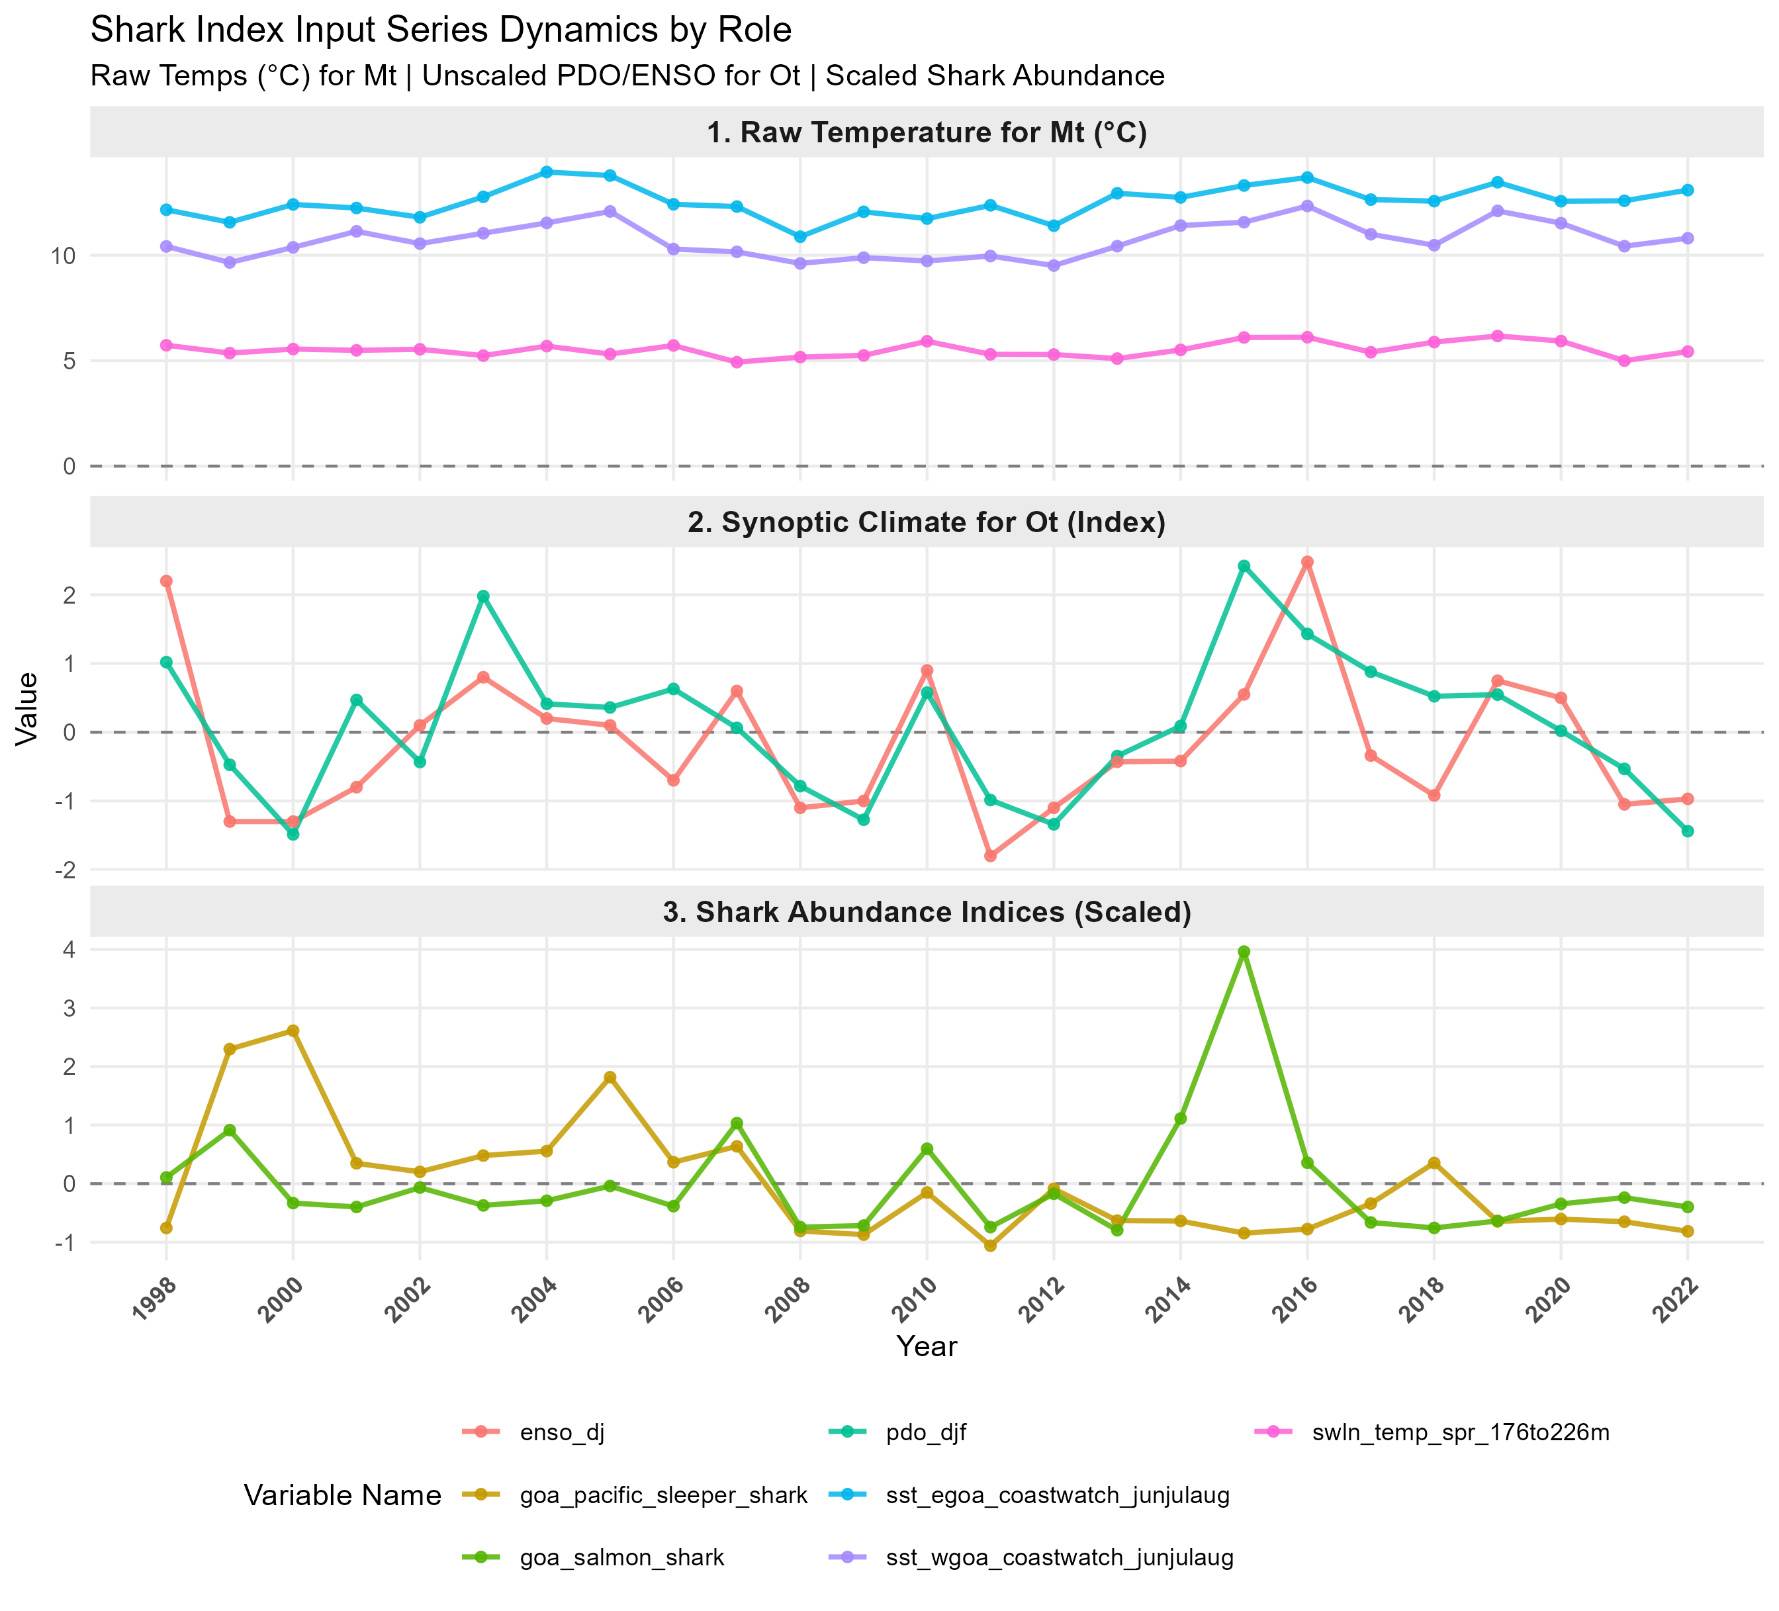
Shark index
Bioenergetics + foraging arena theory (Ecosim)
i_shark = log(n_shark)*M(t)*O(t)
Metabolic equation: M(t) = Q₁₀^{((T - Tref) / 10)} Q₁₀=2
where M(t) is the increase in metabolic cost of swimming in a warmer ocean
Overlap equation: O(t)= plogis(β_{shark} T) * 2
where O(t) is an overlap index to capture the compression of suitable habitat for salmon in a warm ocean linear or logistic (0-2) form
Foraging arena theory in Ecosim:
Q_{ij}(T) = a_{ij}*O_{ij}(T)*N_{i}*P_{j}
Walters et al 1997

Slide 9
Ot=plogis(Tscale) * 2

Slide 11
Log-Transformed index
Notes:
Temperature-Driven Spatial Overlap & Functional Responses
Walters, C., Christensen, V., & Pauly, D. (1997). Structuring dynamic models of marine ecosystems: Exploring 'Ecosim' and its application to North Pacific ecosystems. Reviews in Fish Biology and Fisheries, 7(2), 139–172.
Why cite it: Introduces the "Foraging Arena Theory" used in Ecosim. Predation mortality ($M_{i,j}$) on prey $i$ by predator $j$ is explicitly formulated as:
$$Q_{ij} = a_{ij} \cdot O_{ij}(T) \cdot N_i \cdot P_j$$
Where $O_{ij}(T)$ is spatial overlap as a function of environmental drivers (temperature), $P_j$ is predator abundance in non-negative units, and $N_i$ is prey abundance. It proves that overlap ($O_t$) and metabolic scaling ($M_t$) act as scalar multipliers on absolute density ($P$), not on centered/standardized metrics.
Ahrens, R. N., Walters, C. J., & Christensen, V. (2012). Foraging arena theory: The theoretical necessity and empirical evidence. Fish and Fisheries, 13(1), 41–51.
Why cite it: Demonstrates why scaling factors must remain strictly multiplicative ($>0$) on non-negative abundance values to prevent mathematical sign inversion in functional response equations.

Slide 12
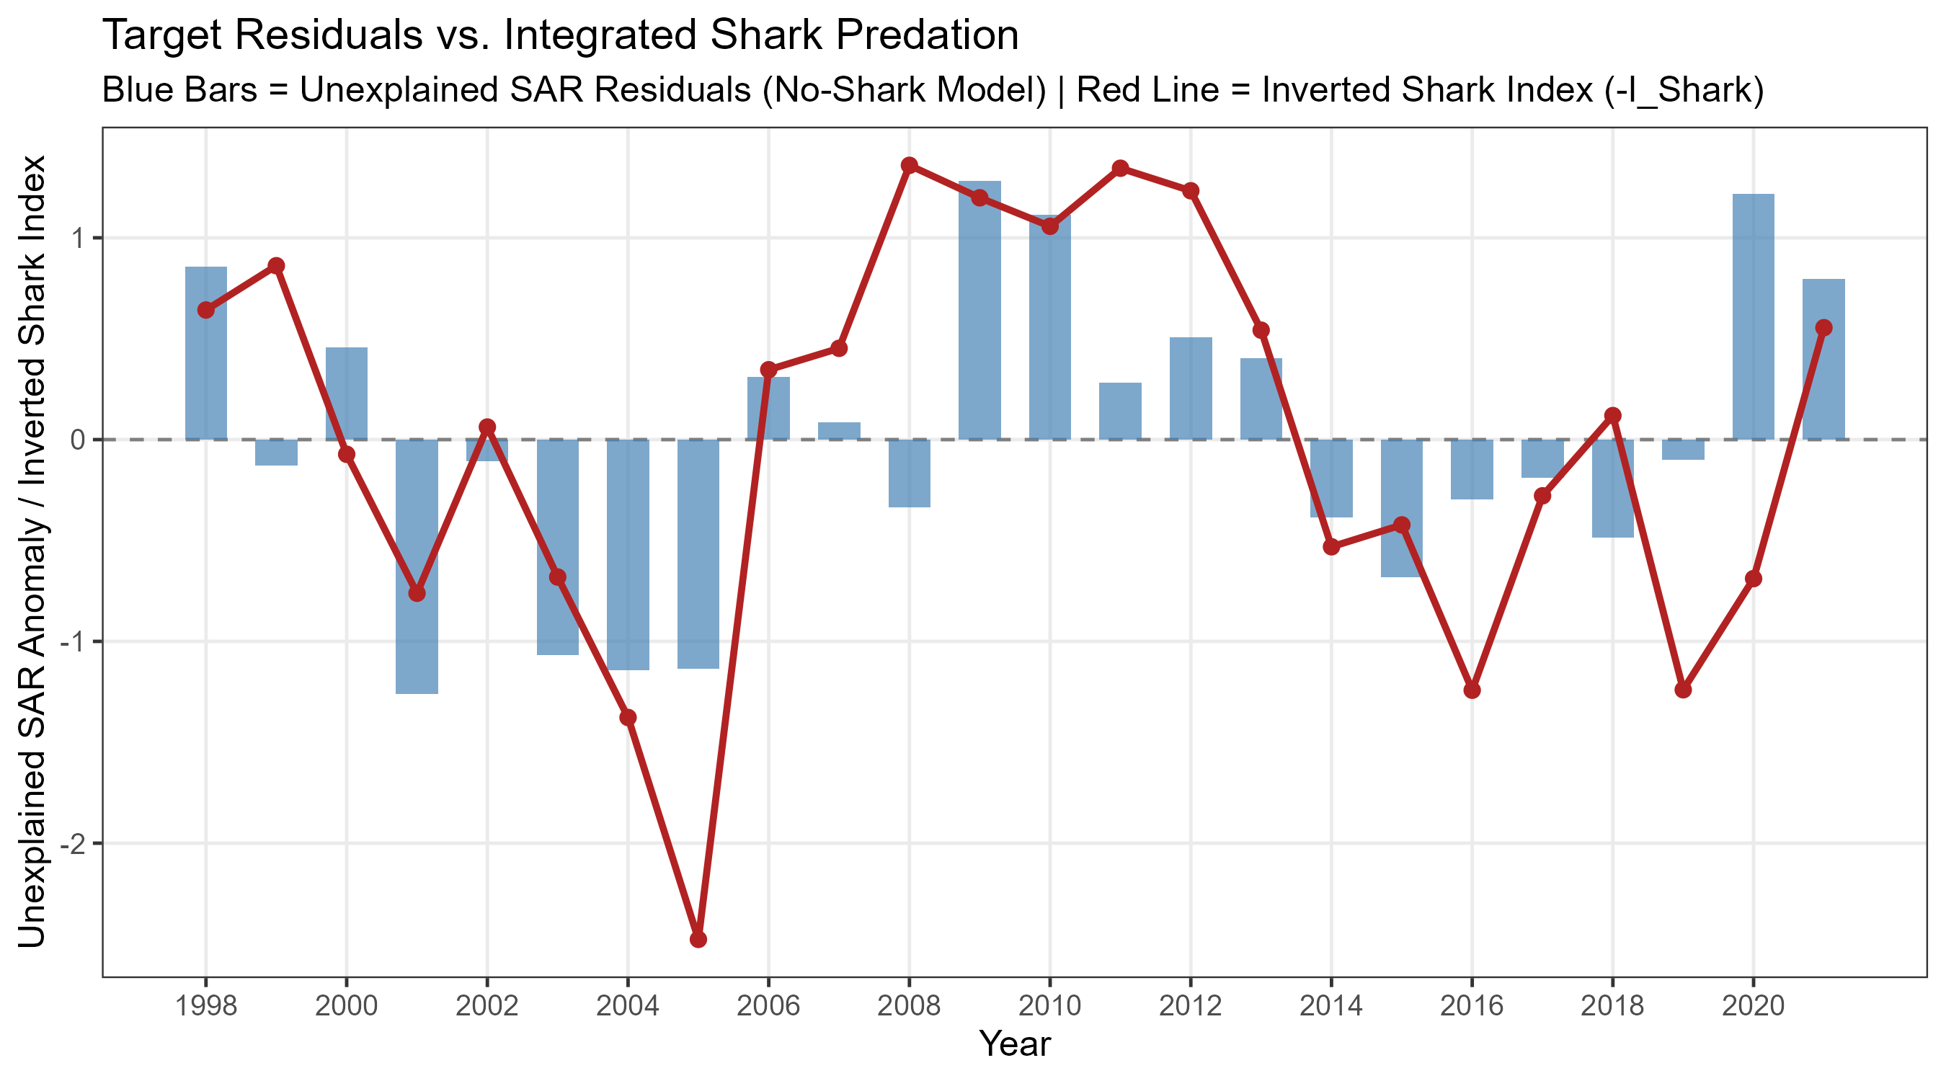

Slide 13
SSL in GOA

Slide 14
Simple assumption: herring and capelin serve as a buffer and reduce foraging on salmon temperature intensifies consumption
SSL_{index} ~ SSLcounts + b₁*SST + b₂*herring + b₃*capelin
Herring data is more reliable in this case, actual abundance for multiple populations along the SEAK coast, compared to bird diets on an isolated island
Notes:
Yes, there is strong empirical and bioenergetic literature justifying why herring receives higher weighting than capelin (such as a 2:1 ratio) in a Steller sea lion (SSL) foraging model.
You can defend this choice using two distinct mechanisms: Bioenergetic/Caloric Density and Spatial Proximity/Phenology.
1. Bioenergetic Justification: Caloric & Fat Content
Herring is substantially more energy-dense than capelin, meaning a sea lion gets roughly twice the caloric return per kilogram of herring consumed.
Direct Caloric Ratios: Controlled feeding studies on Steller sea lions (Kastelein et al., 2000; Rosen & Trites, 2004) show that adult herring averages 8.5–10.5 kJ/g, whereas capelin averages 4.5–6.0 kJ/g. This creates a near 2:1 caloric ratio in raw energy density.
Digestive Limits & Compensatory Feeding: Rosen & Trites (2004) (Canadian Journal of Zoology) directly tested SSL feeding rates on herring vs. capelin. They demonstrated that sea lions had to consume 14.0 kg/day of capelin to achieve the same gross energy intake as 8.3 kg/day of herring—nearly an 80% increase in mass requirements due to gut capacity limits.
Literature Reference: Logerwell & Schaufler (2005) (Aquatic Mammals) conducted proximate analyses on Gulf of Alaska forage fish, ranking Pacific herring at the absolute top of lipid/energy density among SSL prey, with capelin falling into an intermediate category.
2. Spatial & Data-Quality Justification: Regional Overlap
Beyond bioenergetics, the higher weighting on herring can be defended by the spatial alignment of your datasets:
Herring as a Primary Coastal Buffer: Adult Pacific herring form massive, highly predictable overwintering aggregations in coastal corridors (e.g., SEAK, Prince William Sound) where salmon smolts migrate out along the shelf. High herring biomass holds sea lions in localized coastal arenas, directly buffering smolts.
Capelin Proxy Distance: As you noted, your capelin proxy comes from Middleton Island seabird diets. While excellent for tracking central shelf surface-forage trends, seabird chick diet proportions reflect localized foraging radii (~50 km around Middleton) and can be noisier than regional herring stock assessments.
How to Write This in Your Methods Section
To preempt reviewer criticism, write a simple justification sentence like this:
"The higher weighting assigned to herring relative to capelin ($2:1$ ratio) reflects established bioenergetic and empirical differences in prey quality: Pacific herring in the Gulf of Alaska exhibits roughly double the lipid and caloric density ($\sim 8.5\text{--}10.5\text{ kJ/g}$) of capelin ($\sim 4.5\text{--}6.0\text{ kJ/g}$), requiring significantly higher mass intake of capelin to achieve equivalent energetic buffer thresholds (Logerwell & Schaufler 2005; Rosen & Trites 2004)."
Key References:
Rosen, D. A., & Trites, A. W. (2004). Satiation and compensation for short-term changes in food quality and availability by Steller sea lions (Eumetopias jubatus). Canadian Journal of Zoology, 82(7), 1061–1069.
Logerwell, E. A., & Schaufler, L. E. (2005). New data on proximate composition and energy density of Steller sea lion (Eumetopias jubatus) prey species. Aquatic Mammals, 31(1), 22–37.

Slide 15
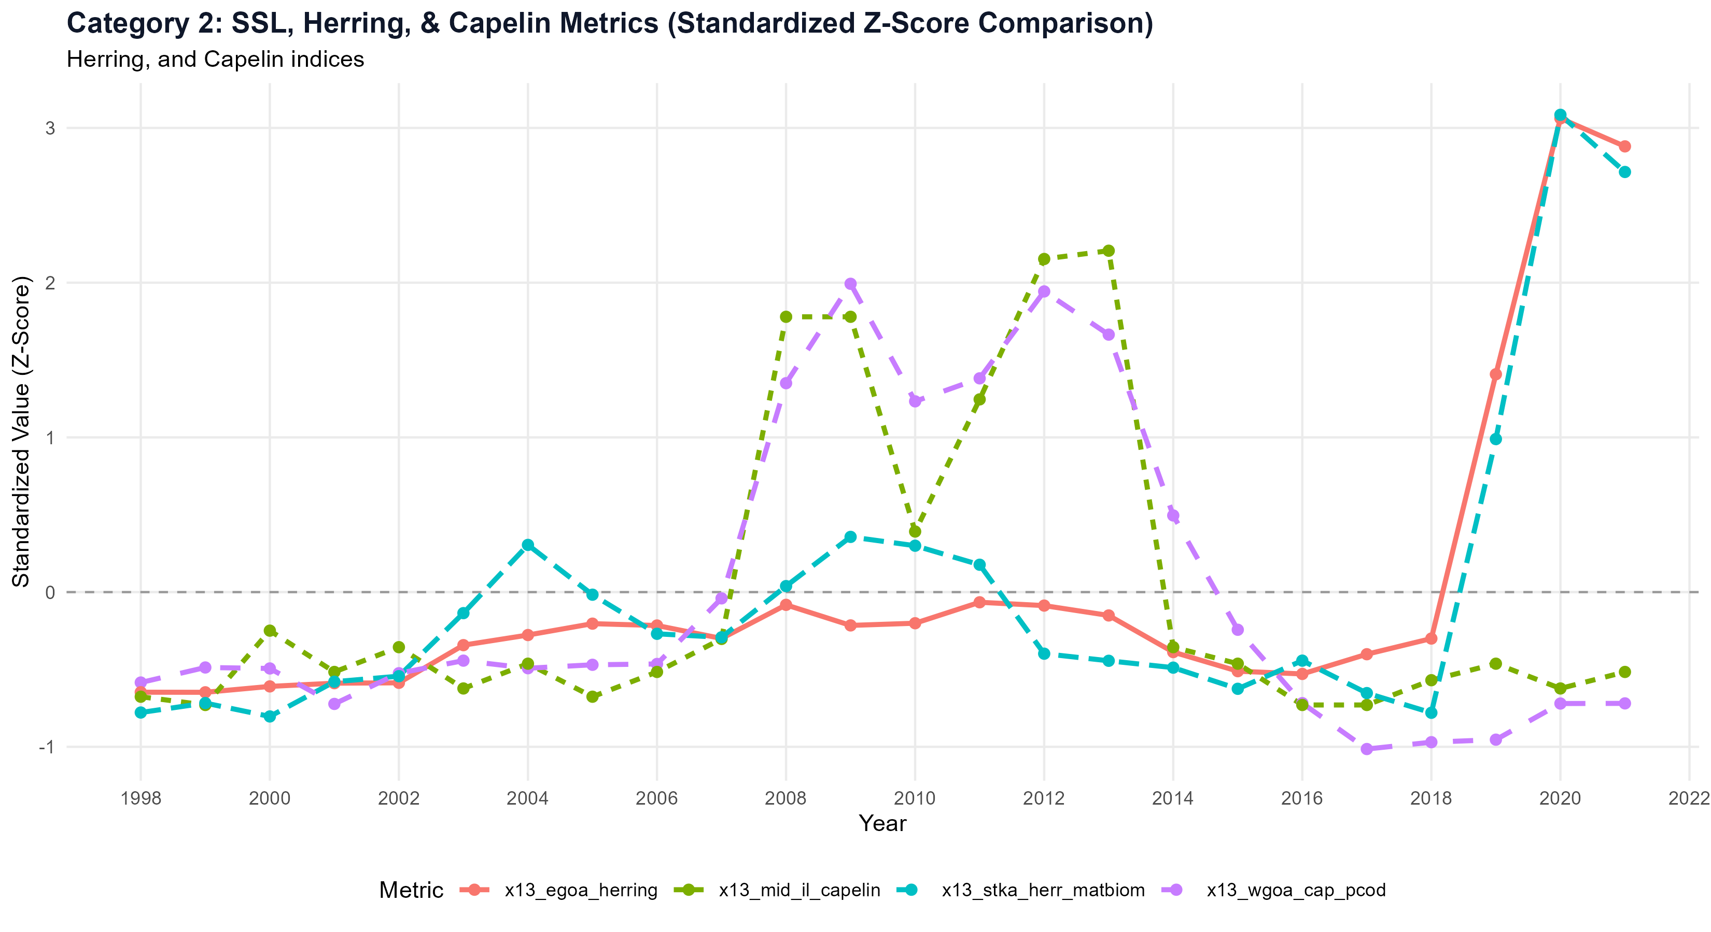
Capelin have pretty strong temperature signal, herring are doing something else

Slide 16
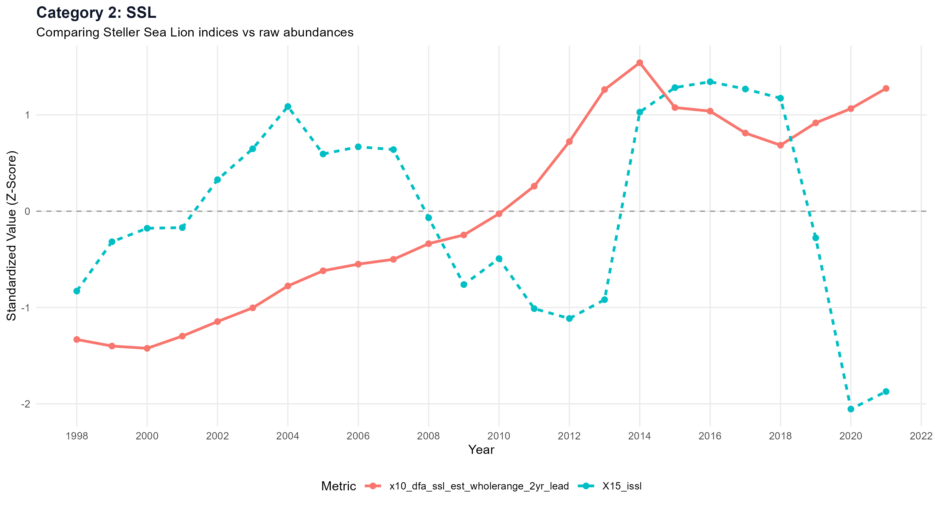
Adds oscillation to linear increase in total N

Slide 17
California sea lions at EMB
Come to the CR in spring, broadly thought to track eulachon run, stay for salmon, leave for mating or something back in CA
SSL have longer residence, recent increases, we only have really good data at Bonn
Primarily target eulachon when they are available
About 1/3 spend most time in the river, 2/3 focused more on ocean prey
At Bonneville they target mostly salmon and shad

Slide 18
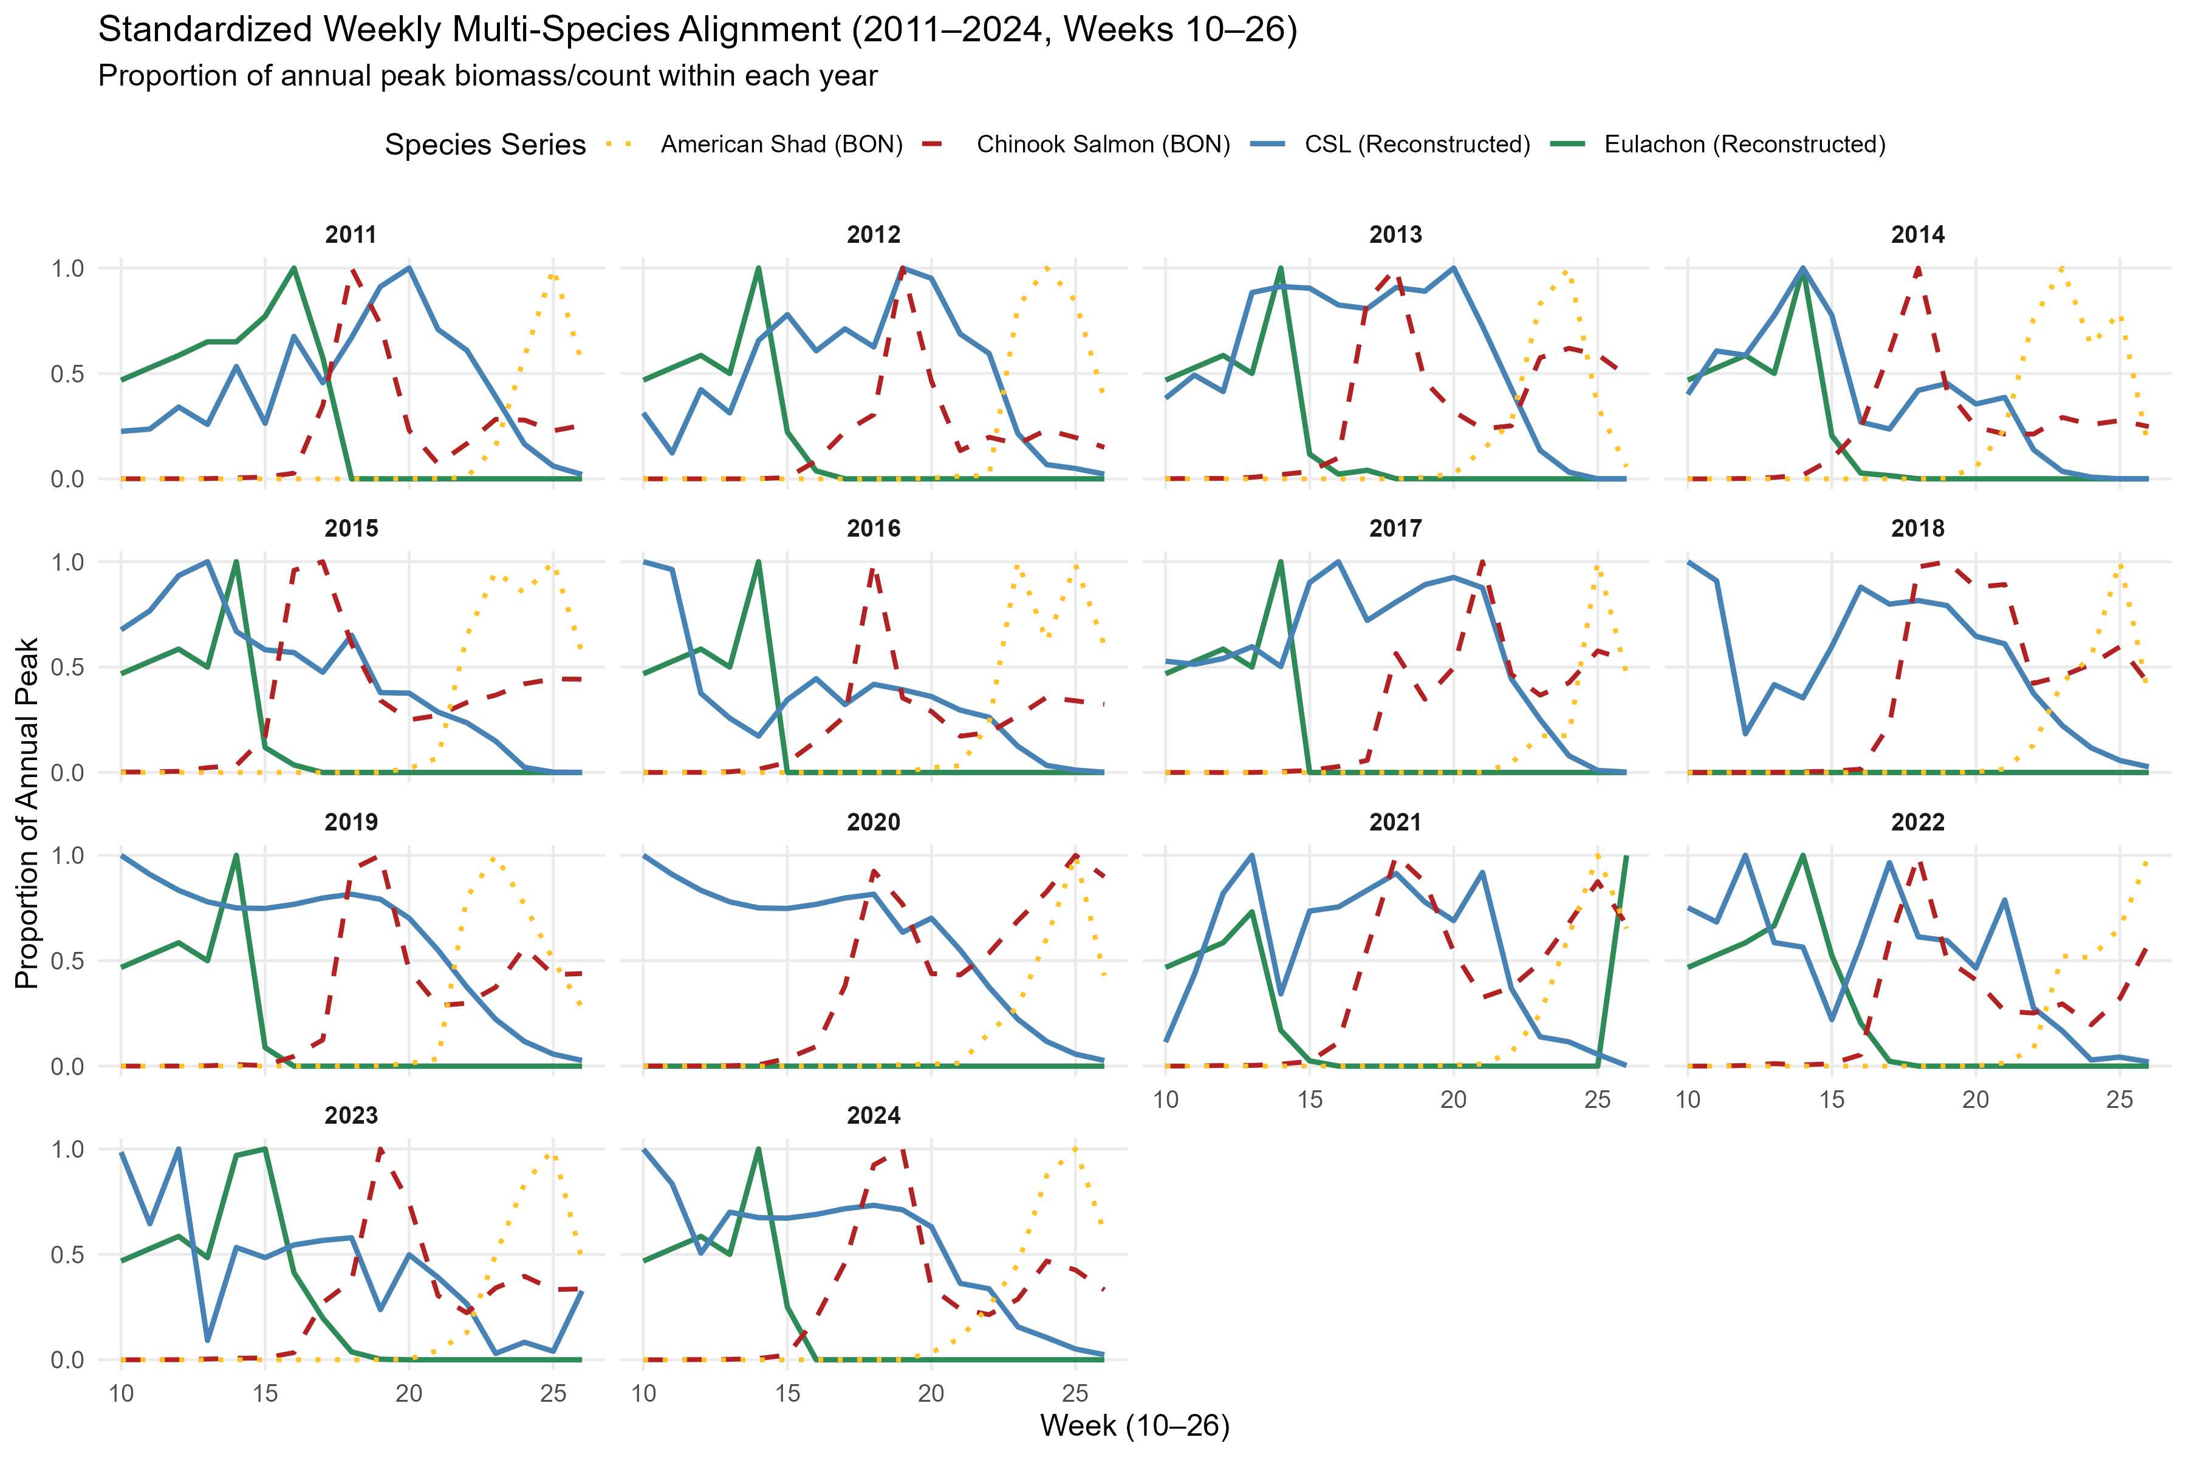
CSL, eulachon, salmon, shad phenology

Slide 19
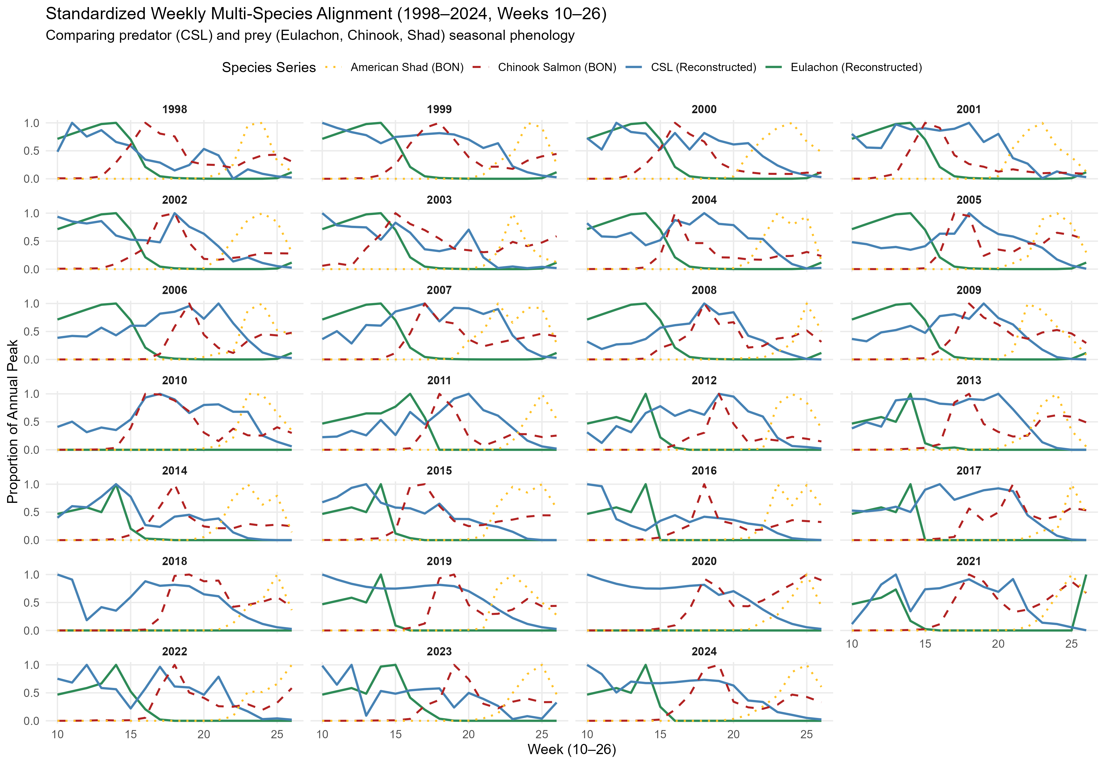
Extrapolate run overlap to 1998

Slide 20
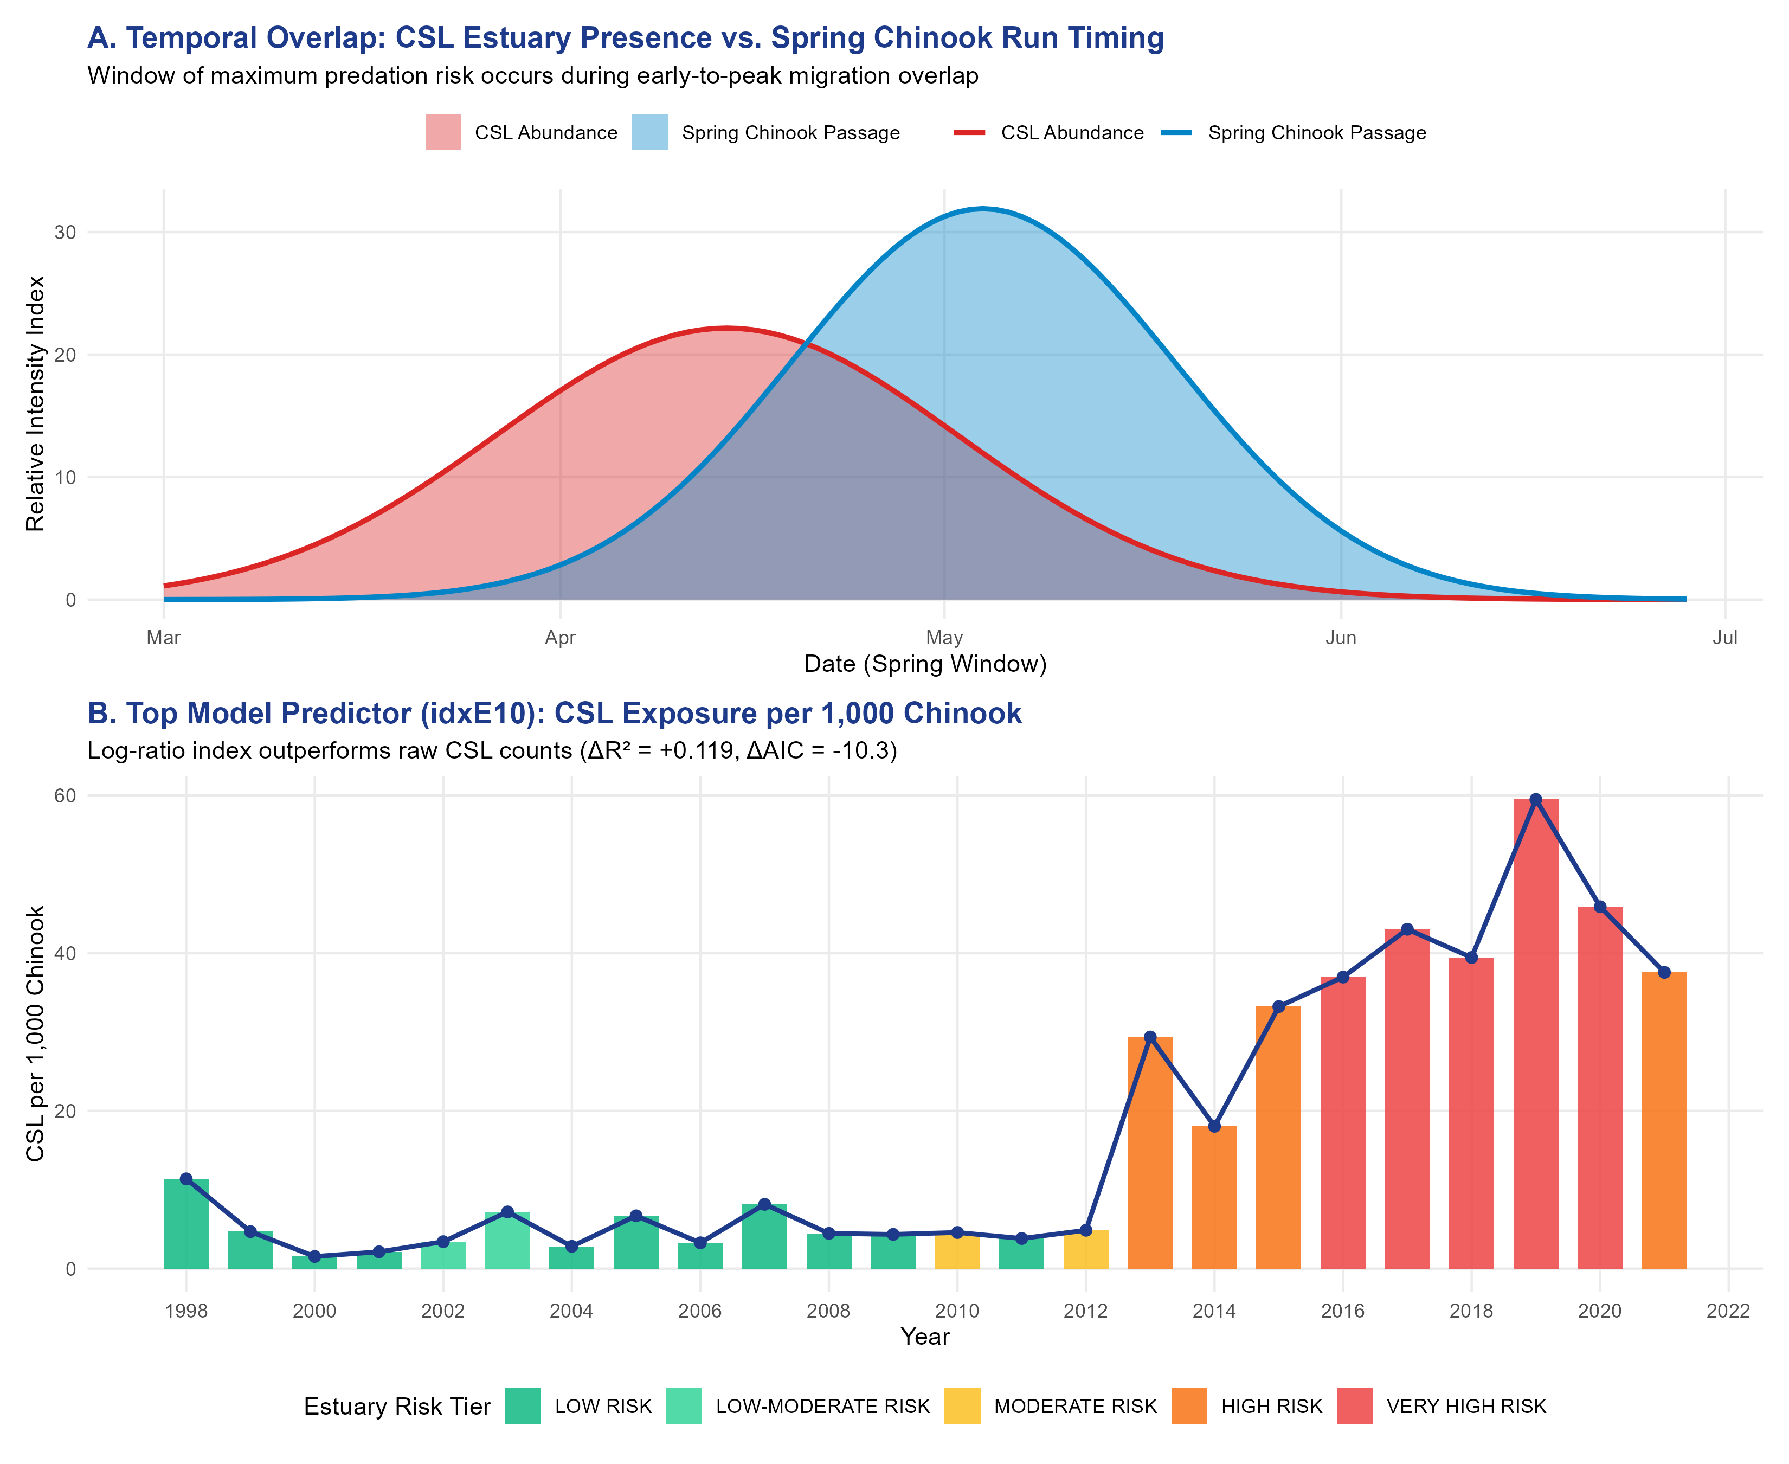

Slide 21
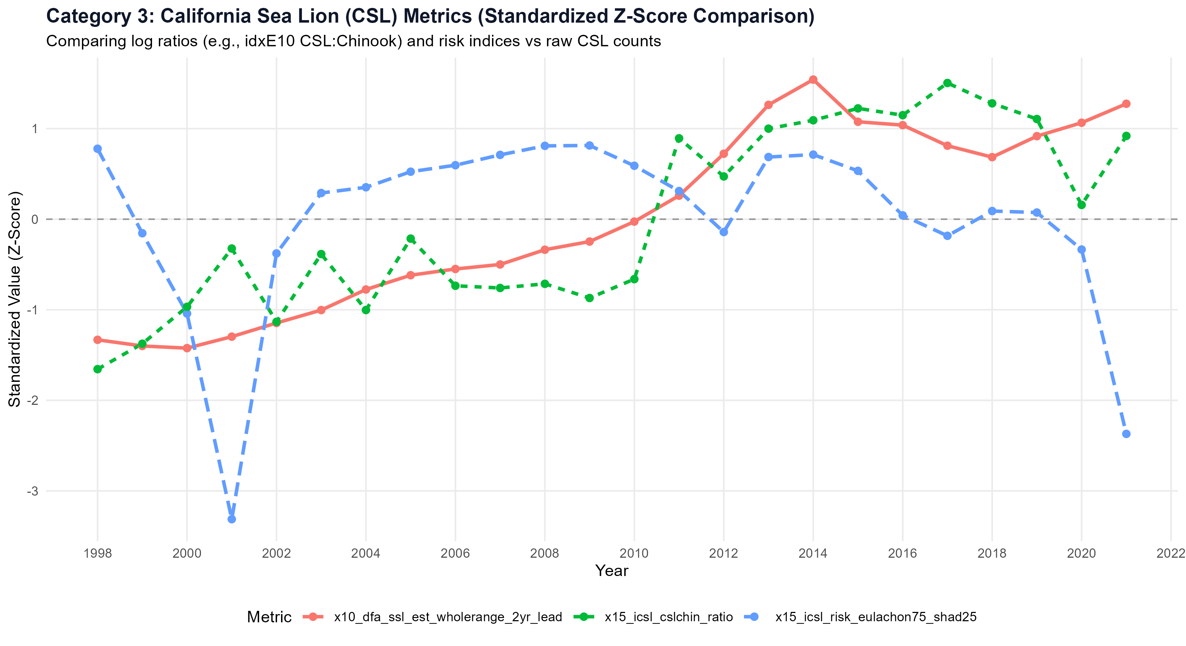

Slide 22
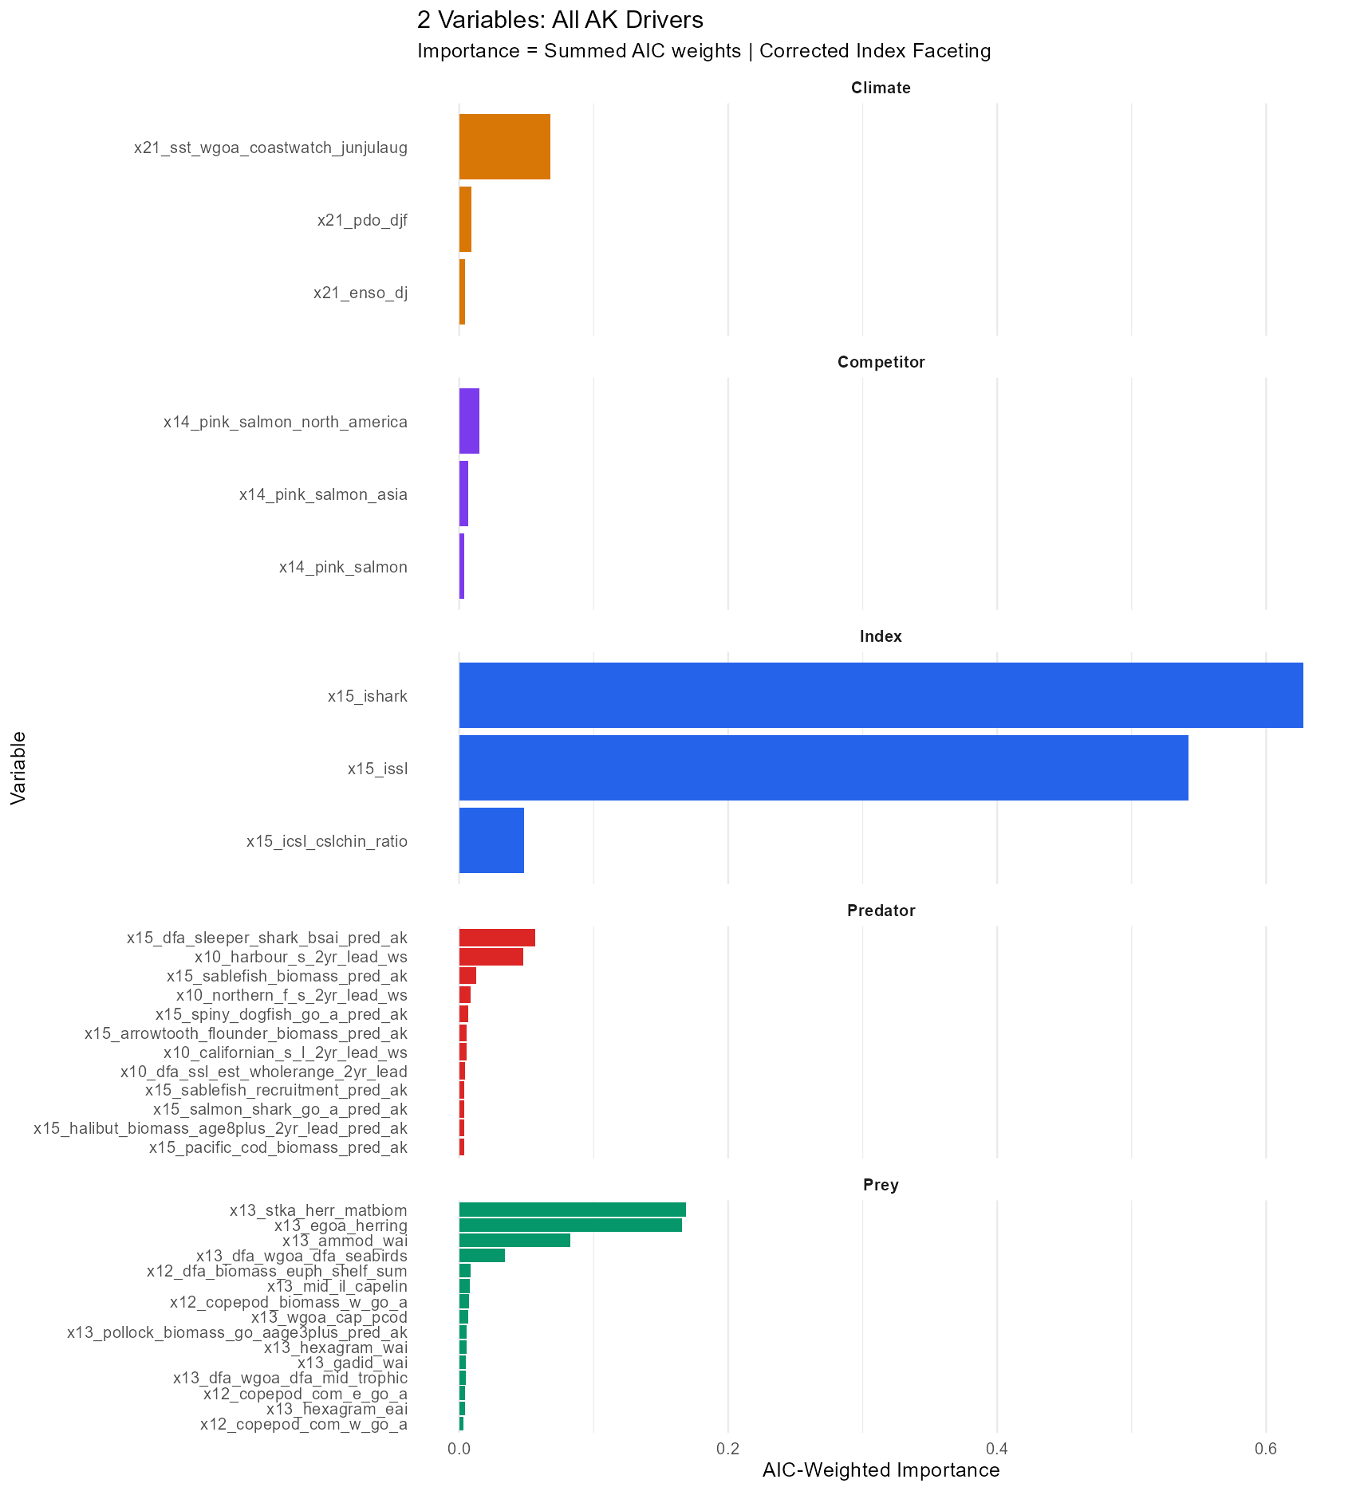
var_group | exp_sign | evaluations | raw_prop_met | aic_weighted_prop_met
Index | Negative | 114 | 0.982 | 1
Climate | Negative | 114 | 0.886 | 0.934
Predator | Negative | 456 | 0.469 | 0.754
Prey | Positive | 678 | 0.617 | 0.711
Competitor | Negative | 114 | 0.36 | 0.595
variable | var_group | exp_sign | importance | prop_sign_met_aic_wtd
x15_ishark | Index | Negative | 0.6277 | 1
x15_issl | Index | Negative | 0.542 | 1
x13_stka_herr_matbiom.x | Prey | Positive | 0.0844 | 0.98
x13_stka_herr_matbiom.y | Prey | Positive | 0.0844 | 0.98
x13_egoa_herring | Prey | Positive | 0.083 | 0.979
x13_ammod_wai | Prey | Positive | 0.0828 | 0
x21_sst_wgoa_coastwatch_junjulaug | Climate | Negative | 0.068 | 0.986
x15_dfa_sleeper_shark_bsai_pred_ak | Predator | Negative | 0.0563 | 1
x15_icsl_cslchin_ratio | Index | Negative | 0.0481 | 0.999
x10_harbour_s_2yr_lead_ws | Predator | Negative | 0.0474 | 1
x13_dfa_wgoa_dfa_seabirds | Prey | Positive | 0.0338 | 0
x14_pink_salmon_north_america | Competitor | Negative | 0.0148 | 1
x15_sablefish_biomass_pred_ak | Predator | Negative | 0.0125 | 0.217
x21_pdo_djf | Climate | Negative | 0.0089 | 1
x12_dfa_biomass_euph_shelf_sum | Prey | Positive | 0.0087 | 0

Slide 25
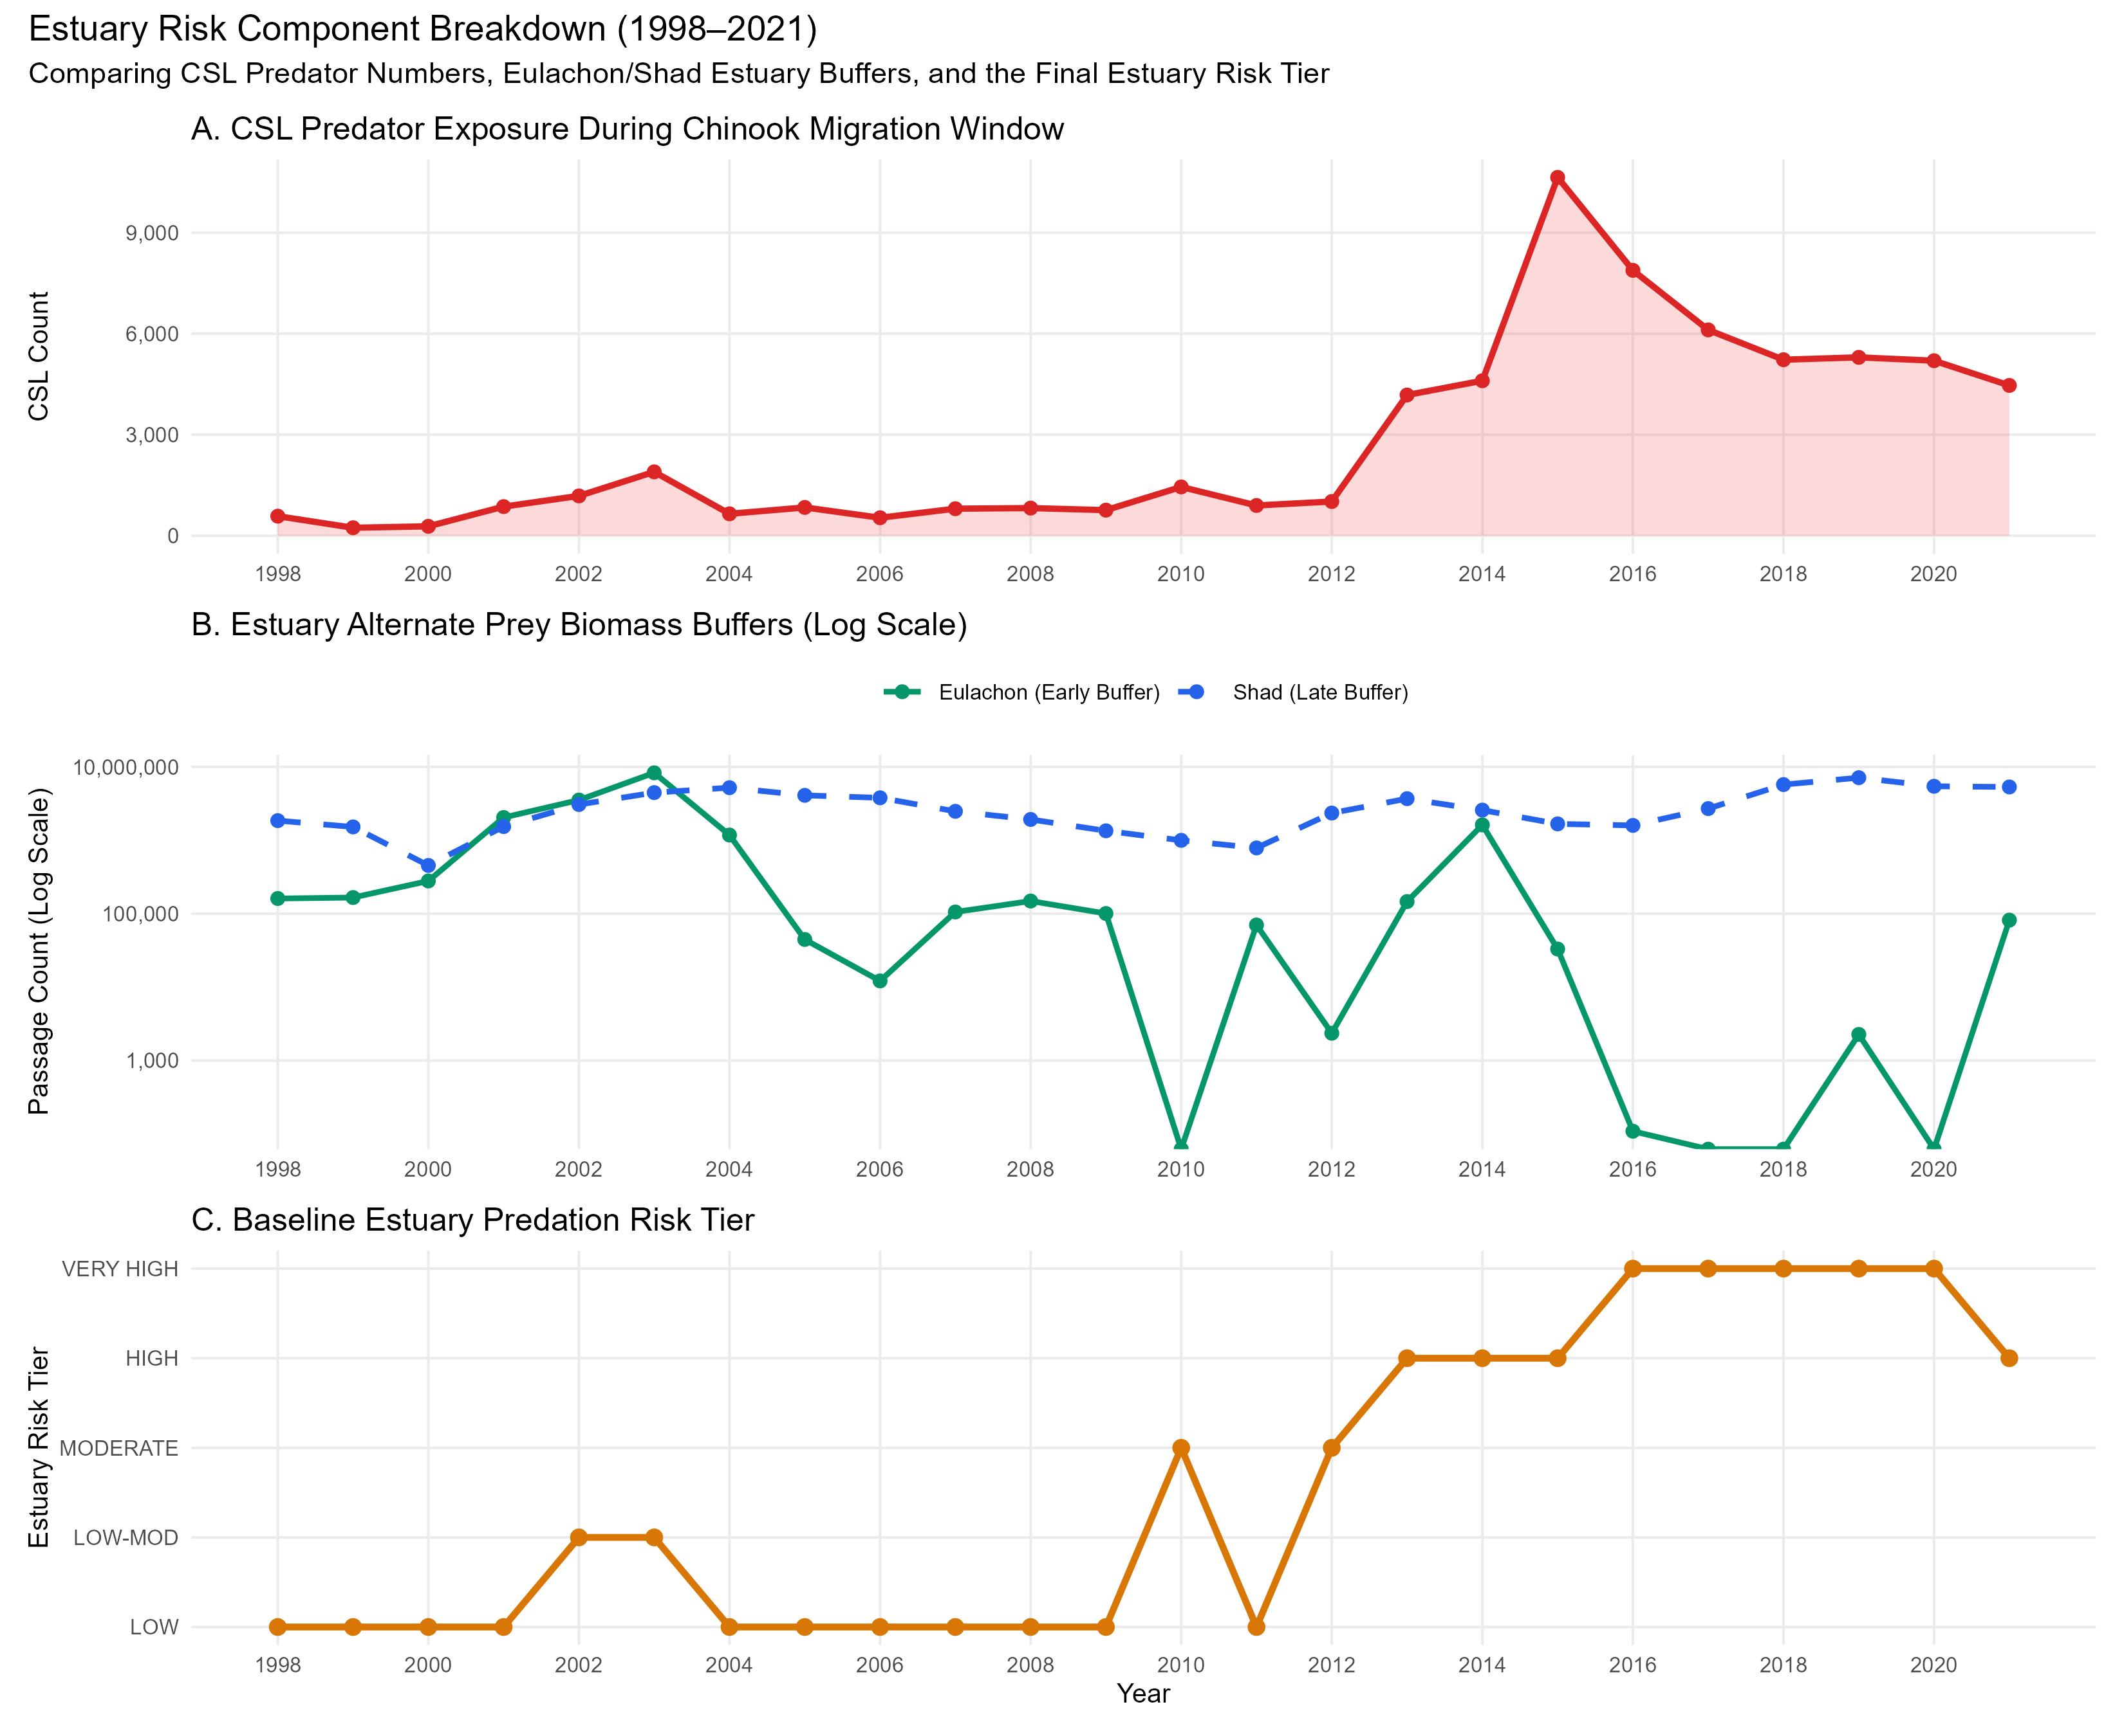
Components of estuary risk score

Slide 26
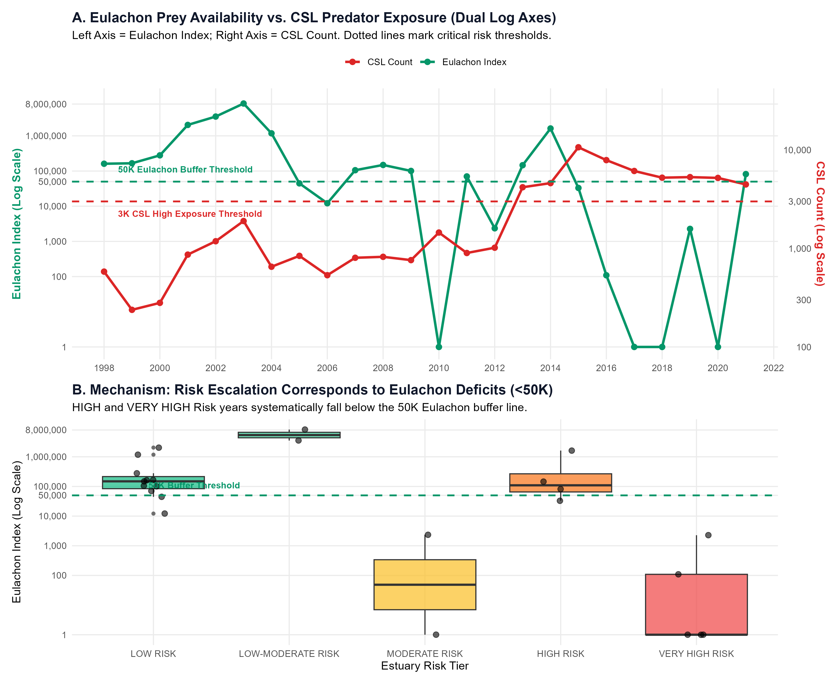

Slide 27
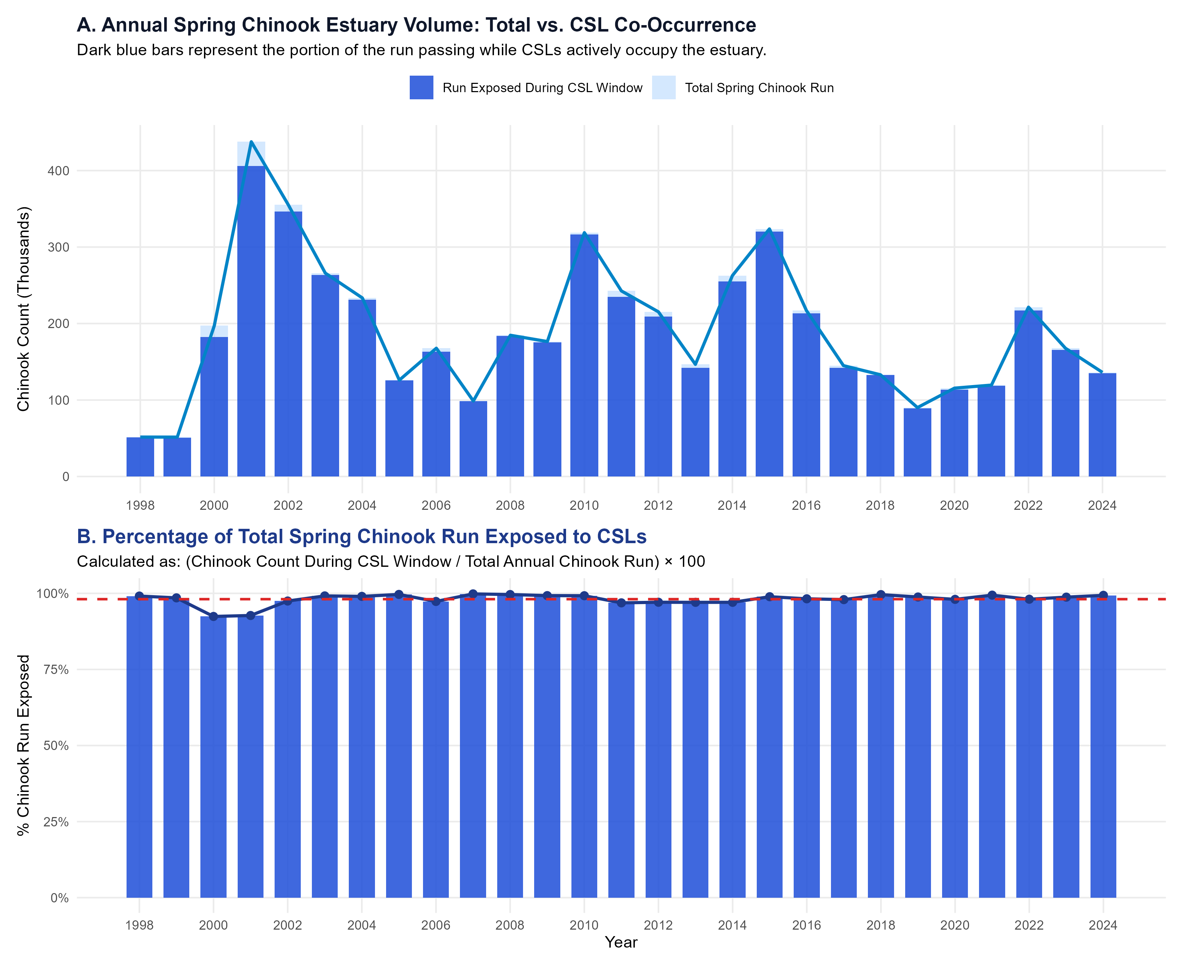

Slide 28
Current DFA – captures 2015 peak

Slide 29
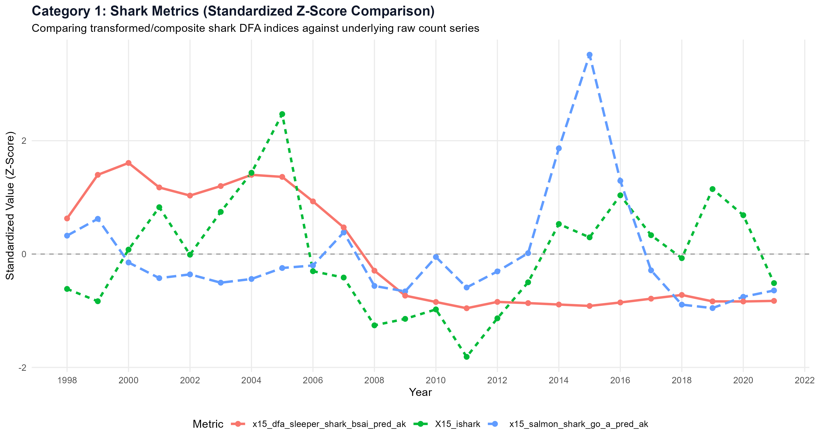

Slide 30
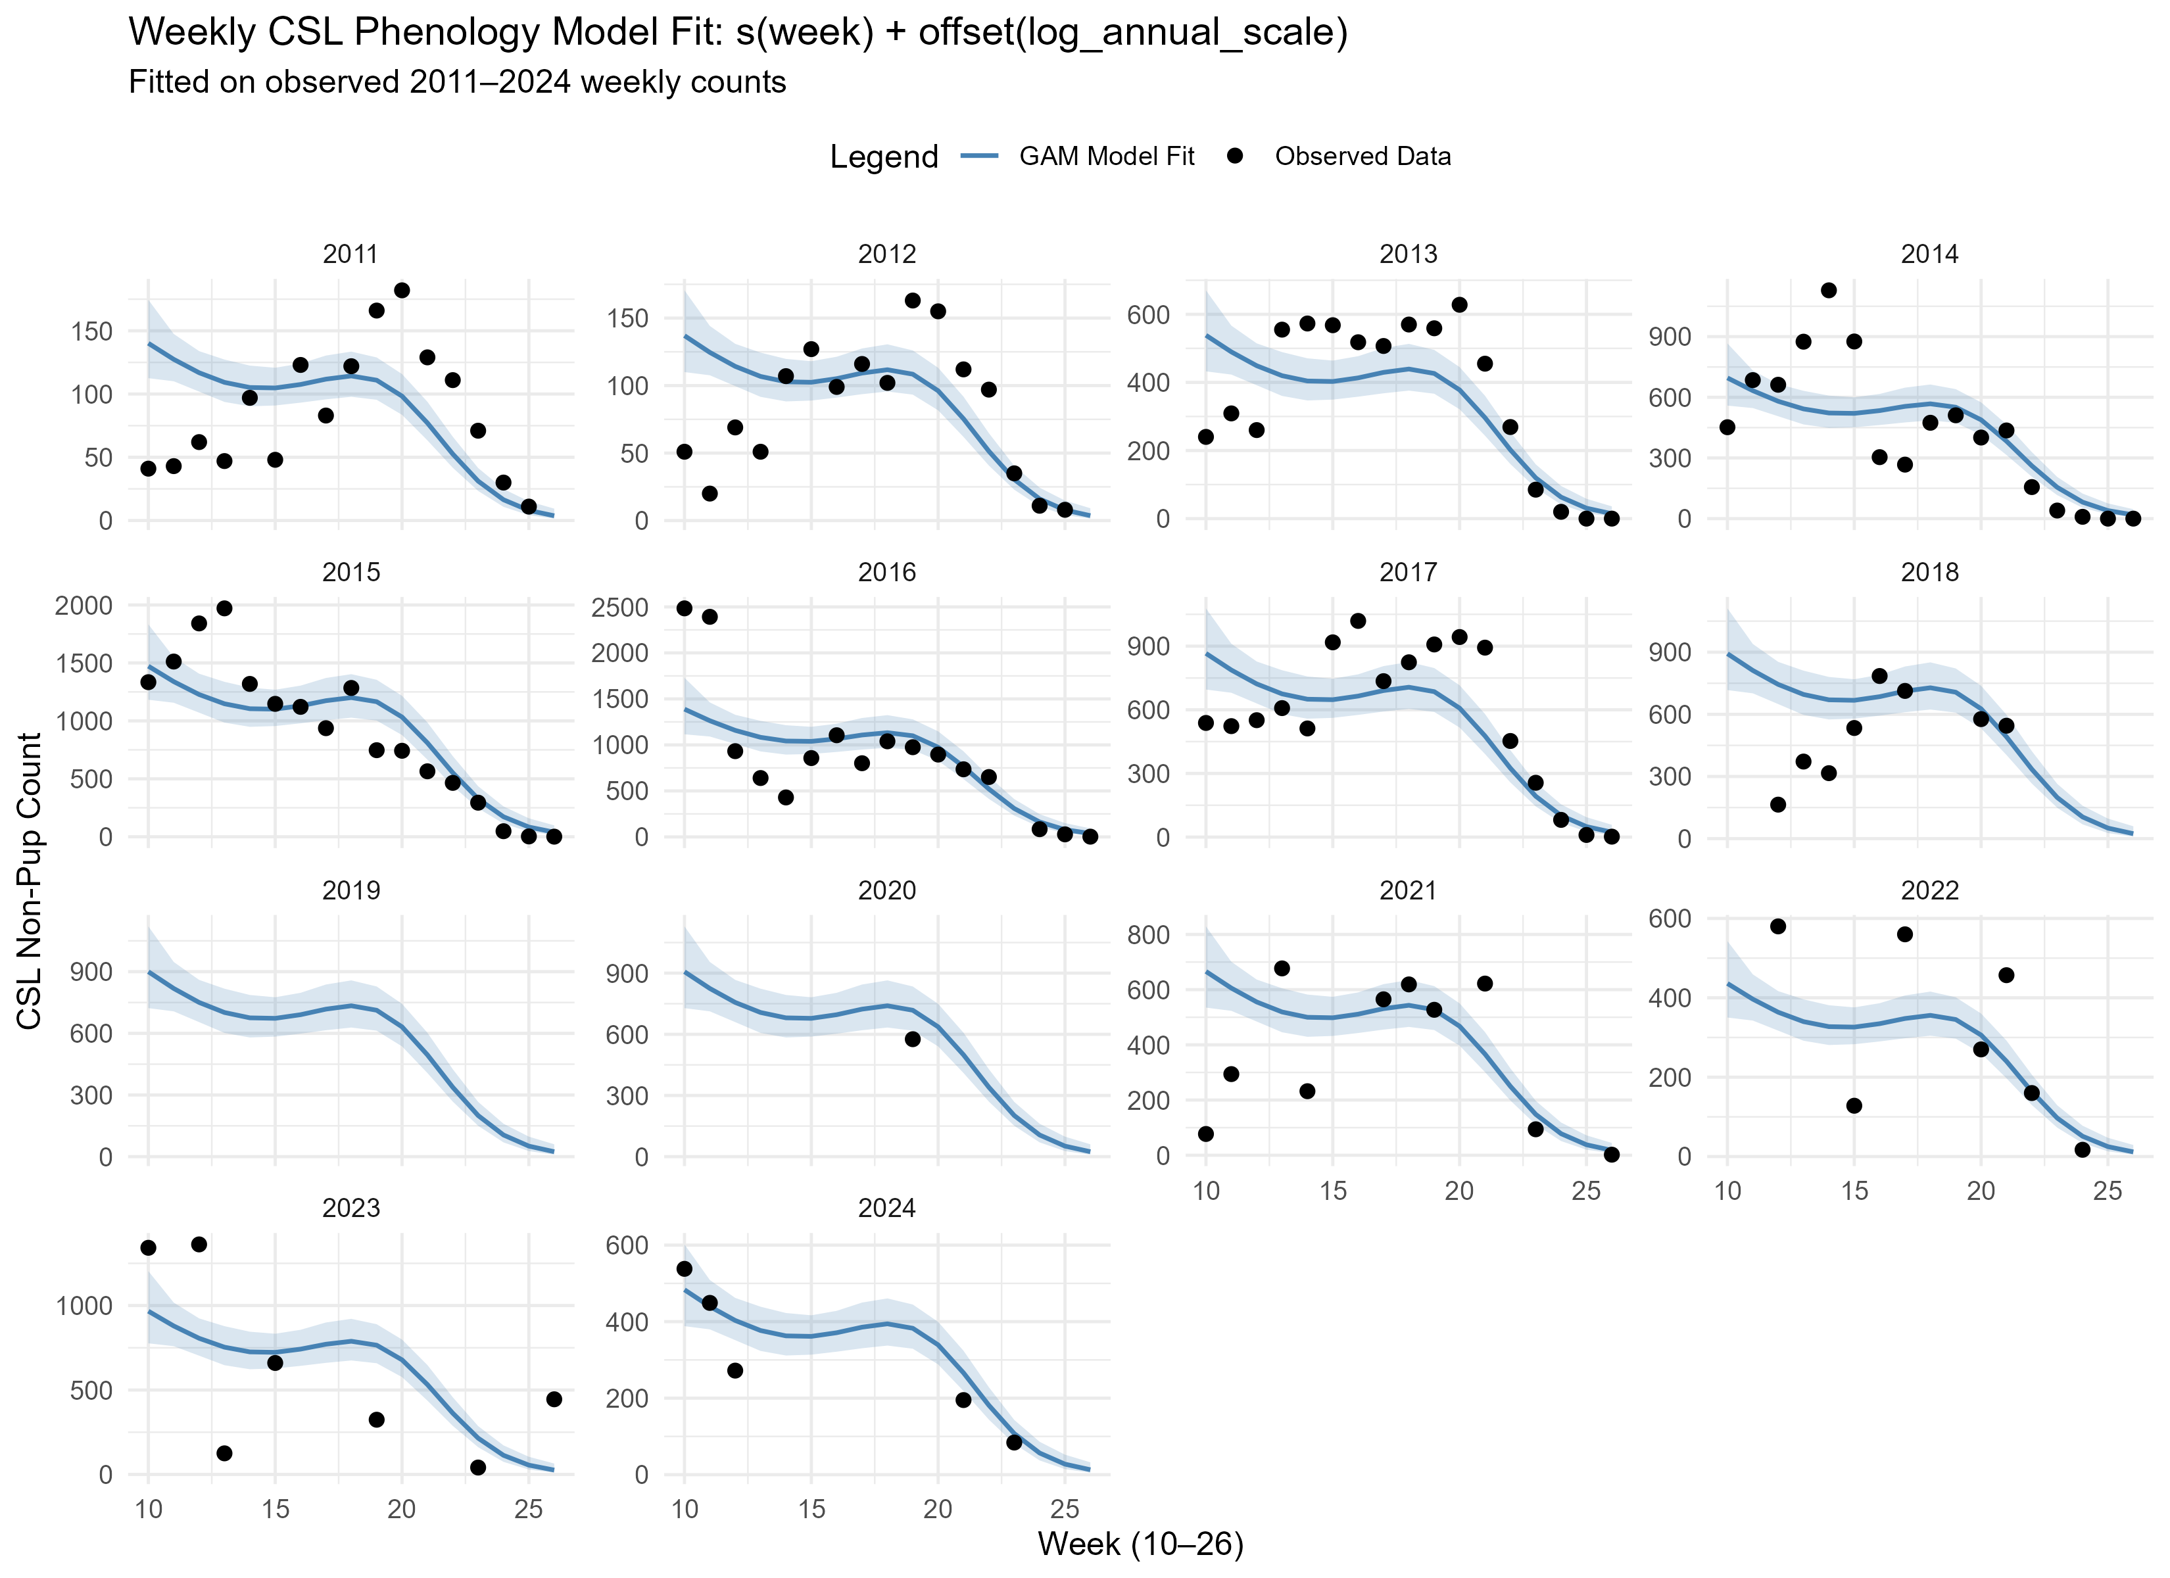
CSL at EMB spring phenology

Slide 31
CSL phenology ~ eulachon, salmon, shad

Slide 32
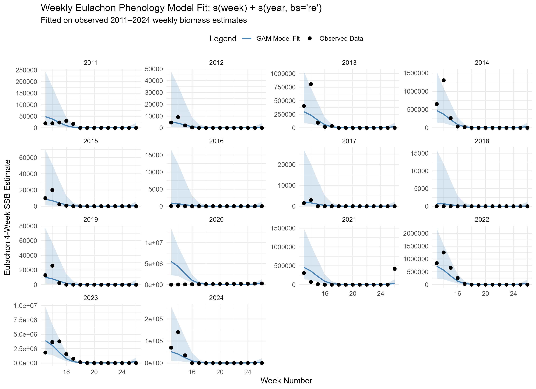
GAM-fit to backfill weekly eulachon run

Slide 33
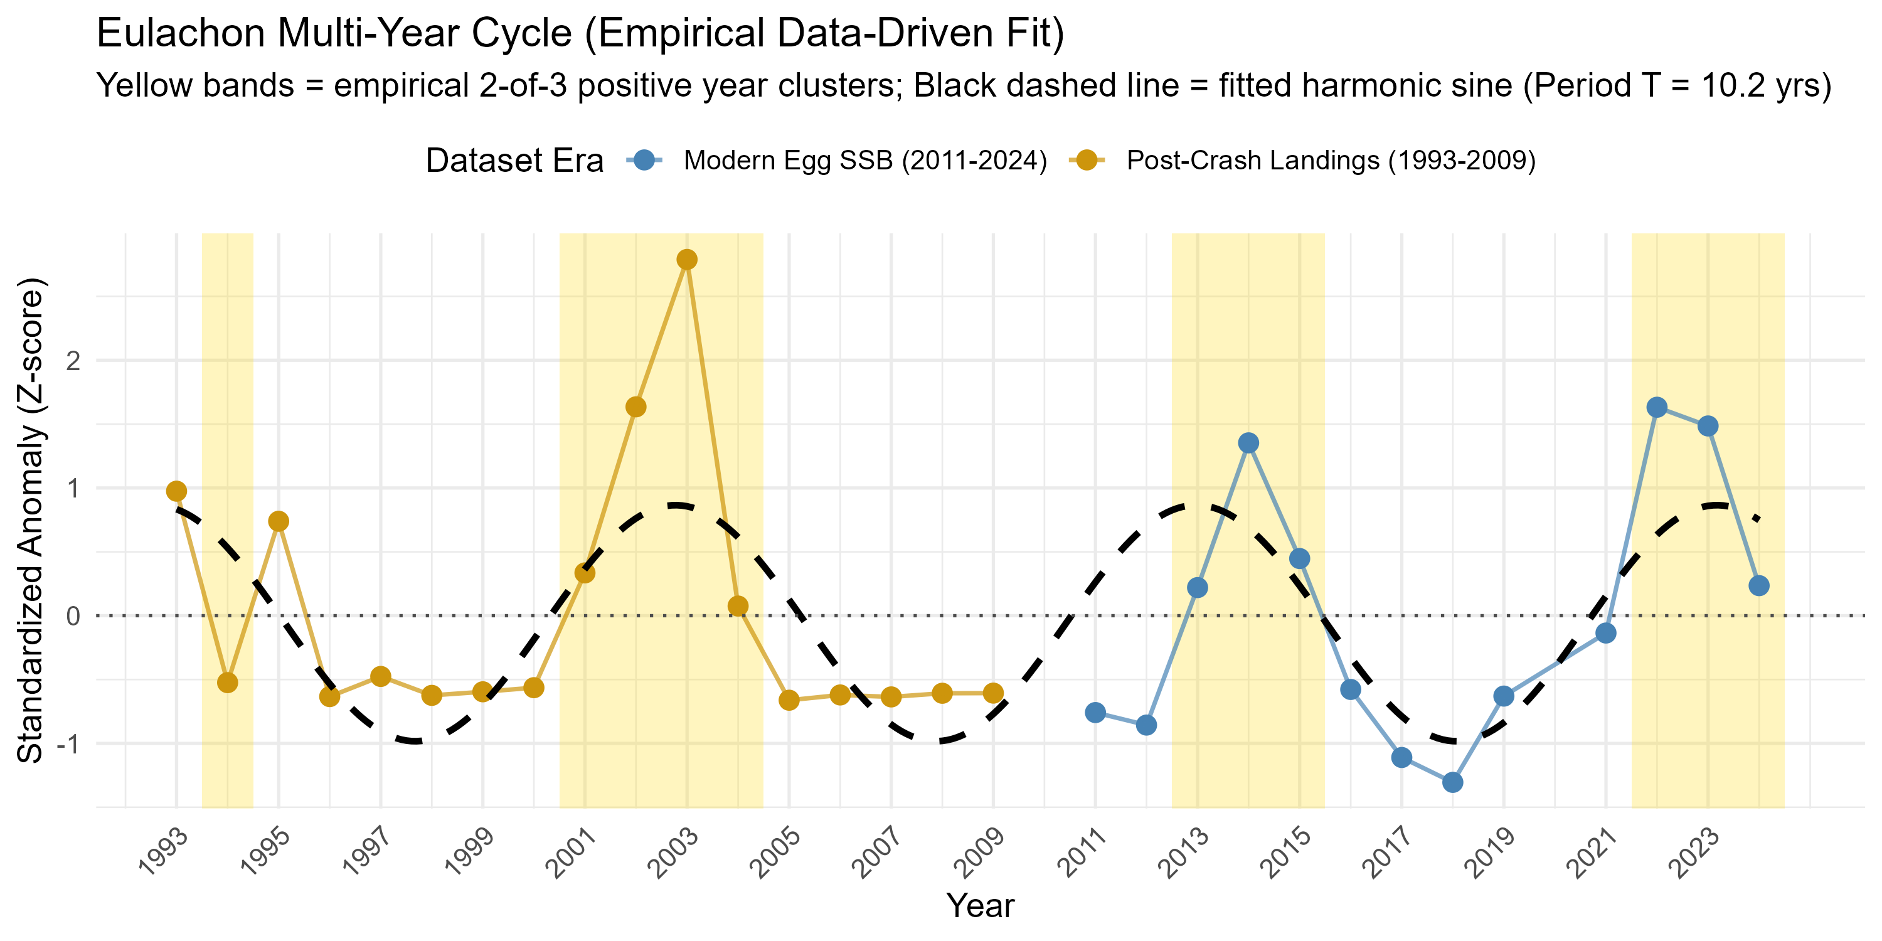
Sine-fit to combine catch data w/ egg counts

Slide 34
Exposure indices tested
Qualitative score
Csl count during the salmon run (sum/weekly avg)
CSL annual peak
N_{total} chinook in estuary (sum over whole spring)
N_{total} eulachon in estuary (sum over whole spring)
N_{eul(chin)} sum of eulachon during chinook run
N_{shad(chin)} sum of shad during chinook run
# 1. Sea Lion Exposure Tier (Absolute counts during Chinook run)
csl_threat_tier = case_when(
csl_during_chinook >= 3000 ~ "High CSL Exposure (>3k)",
csl_during_chinook >= 1000 ~ "Moderate CSL Exposure (1k-3k)",
TRUE ~ "Low CSL Exposure (<1k)"
),
# 2. Early Spring Eulachon Buffer Scale
eulachon_buffer_tier = case_when(
eulachon_during_chinook >= 50000 ~ "Substantial Buffer (>50k)",
eulachon_during_chinook >= 10000 ~ "Moderate Buffer (10k-50k)",
TRUE ~ "Minimal Buffer (<10k)"
),
# 3. Late Spring Shad Buffer Scale
shad_buffer_tier = case_when(
shad_during_chinook >= 100000 ~ "Major Late Buffer (>100k)",
shad_during_chinook >= 20000 ~ "Moderate Late Buffer (20k-100k)",
TRUE ~ "Minimal Late Buffer (<20k)"
),
Csl_05b_risktable_numeric.r

Slide 35
Risk scoring
# Composite Qualitative Risk Ranking
overall_chinook_risk = case_when(
csl_threat_tier == "High CSL Exposure (>3k)" & eulachon_buffer_tier == "Minimal Buffer (<10k)" ~ "VERY HIGH RISK",
csl_threat_tier == "High CSL Exposure (>3k)" ~ "HIGH RISK",
csl_threat_tier == "Moderate CSL Exposure (1k-3k)" & eulachon_buffer_tier == "Substantial Buffer (>50k)" ~ "LOW-MODERATE RISK",
csl_threat_tier == "Moderate CSL Exposure (1k-3k)" ~ "MODERATE RISK",
TRUE ~ "LOW RISK"
)
)
Threat tiers
year | csl_during_chinook | csl_weekly_avg_chin | csl_annual_peak | chinook_estuary_total | eulachon_during_chinook | shad_during_chinook | csl_threat_tier | eulachon_buffer_tier | shad_buffer_tier | overall_chinook_risk
1998 | 582 | 45 | 114 | 51112 | 161163 | 1852775 | Low CSL Exposure (<1k) | Substantial Buffer (>50k) | Major Late Buffer (>100k) | LOW RISK
1999 | 238 | 20 | 31 | 50744 | 166093 | 1521323 | Low CSL Exposure (<1k) | Substantial Buffer (>50k) | Major Late Buffer (>100k) | LOW RISK
2000 | 280 | 28 | 44 | 182233 | 279254 | 454228 | Low CSL Exposure (<1k) | Substantial Buffer (>50k) | Major Late Buffer (>100k) | LOW RISK
2001 | 866 | 79 | 111 | 405879 | 2043469 | 1539014 | Low CSL Exposure (<1k) | Substantial Buffer (>50k) | Major Late Buffer (>100k) | LOW RISK
2002 | 1183 | 99 | 190 | 346306 | 3531401 | 3069988 | Moderate CSL Exposure (1k-3k) | Substantial Buffer (>50k) | Major Late Buffer (>100k) | LOW-MODERATE RISK
2003 | 1897 | 136 | 299 | 263723 | 8295187 | 4462176 | Moderate CSL Exposure (1k-3k) | Substantial Buffer (>50k) | Major Late Buffer (>100k) | LOW-MODERATE RISK
2004 | 652 | 54 | 89 | 231201 | 1178617 | 5206649 | Low CSL Exposure (<1k) | Substantial Buffer (>50k) | Major Late Buffer (>100k) | LOW RISK
2005 | 841 | 76 | 139 | 125579 | 44592 | 4094470 | Low CSL Exposure (<1k) | Moderate Buffer (10k-50k) | Major Late Buffer (>100k) | LOW RISK
2006 | 535 | 59 | 88 | 163287 | 12157 | 3790099 | Low CSL Exposure (<1k) | Moderate Buffer (10k-50k) | Major Late Buffer (>100k) | LOW RISK
2007 | 804 | 67 | 91 | 98562 | 105591 | 2480456 | Low CSL Exposure (<1k) | Substantial Buffer (>50k) | Major Late Buffer (>100k) | LOW RISK
2008 | 822 | 69 | 134 | 183975 | 148793 | 1923455 | Low CSL Exposure (<1k) | Substantial Buffer (>50k) | Major Late Buffer (>100k) | LOW RISK
2009 | 761 | 69 | 120 | 175173 | 100704 | 1346660 | Low CSL Exposure (<1k) | Substantial Buffer (>50k) | Major Late Buffer (>100k) | LOW RISK
2010 | 1450 | 121 | 181 | 316357 | 0 | 998134 | Moderate CSL Exposure (1k-3k) | Minimal Buffer (<10k) | Major Late Buffer (>100k) | MODERATE RISK
2011 | 899 | 100 | 182 | 235111 | 70238 | 787066 | Low CSL Exposure (<1k) | Substantial Buffer (>50k) | Major Late Buffer (>100k) | LOW RISK
2012 | 1017 | 102 | 163 | 209042 | 2357 | 2349979 | Moderate CSL Exposure (1k-3k) | Minimal Buffer (<10k) | Major Late Buffer (>100k) | MODERATE RISK
2013 | 4179 | 418 | 628 | 142293 | 146334 | 3690625 | High CSL Exposure (>3k) | Substantial Buffer (>50k) | Major Late Buffer (>100k) | HIGH RISK
2014 | 4603 | 418 | 1129 | 254988 | 1620949 | 2577160 | High CSL Exposure (>3k) | Substantial Buffer (>50k) | Major Late Buffer (>100k) | HIGH RISK
2015 | 10640 | 887 | 1971 | 320168 | 33026 | 1672433 | High CSL Exposure (>3k) | Moderate Buffer (10k-50k) | Major Late Buffer (>100k) | HIGH RISK
2016 | 7880 | 716 | 2484 | 213131 | 109 | 1594859 | High CSL Exposure (>3k) | Minimal Buffer (<10k) | Major Late Buffer (>100k) | VERY HIGH RISK
2017 | 6112 | 679 | 1019 | 142017 | 0 | 2702859 | High CSL Exposure (>3k) | Minimal Buffer (<10k) | Major Late Buffer (>100k) | VERY HIGH RISK
2018 | 5227 | 523 | 893 | 132480 | 0 | 5736863 | High CSL Exposure (>3k) | Minimal Buffer (<10k) | Major Late Buffer (>100k) | VERY HIGH RISK
2019 | 5298 | 530 | 900 | 89043 | 2269 | 7124495 | High CSL Exposure (>3k) | Minimal Buffer (<10k) | Major Late Buffer (>100k) | VERY HIGH RISK
2020 | 5197 | 520 | 907 | 113255 | 0 | 5441196 | High CSL Exposure (>3k) | Minimal Buffer (<10k) | Major Late Buffer (>100k) | VERY HIGH RISK
2021 | 4464 | 406 | 677 | 118817 | 81831 | 5326254 | High CSL Exposure (>3k) | Substantial Buffer (>50k) | Major Late Buffer (>100k) | HIGH RISK

Slide 36
hake_age5plus_tier | sardine_tier | sitka_herring_tier | ncc_herring_tier | ncc_anchovy_tier | ocean_buffer_score
Moderate Biomass | High Biomass (Buffer) | Low Biomass (Upper Risk) | High Biomass (Buffer) | Low Biomass (Upper Risk) | 3
Low Biomass (Upper Risk) | Moderate Biomass | Low Biomass (Upper Risk) | High Biomass (Buffer) | Low Biomass (Upper Risk) | 2
Low Biomass (Upper Risk) | Moderate Biomass | Low Biomass (Upper Risk) | Moderate Biomass | Low Biomass (Upper Risk) | 2
Moderate Biomass | Moderate Biomass | Low Biomass (Upper Risk) | Moderate Biomass | Moderate Biomass | 4
Moderate Biomass | Moderate Biomass | Low Biomass (Upper Risk) | Moderate Biomass | Moderate Biomass | 4
Moderate Biomass | High Biomass (Buffer) | Moderate Biomass | High Biomass (Buffer) | Moderate Biomass | 5
High Biomass (Buffer) | High Biomass (Buffer) | High Biomass (Buffer) | High Biomass (Buffer) | High Biomass (Buffer) | 5
High Biomass (Buffer) | High Biomass (Buffer) | Moderate Biomass | Moderate Biomass | High Biomass (Buffer) | 5
Moderate Biomass | High Biomass (Buffer) | Moderate Biomass | Low Biomass (Upper Risk) | High Biomass (Buffer) | 4
Low Biomass (Upper Risk) | High Biomass (Buffer) | Moderate Biomass | Moderate Biomass | Moderate Biomass | 4
Low Biomass (Upper Risk) | High Biomass (Buffer) | High Biomass (Buffer) | Moderate Biomass | Low Biomass (Upper Risk) | 3
Low Biomass (Upper Risk) | High Biomass (Buffer) | High Biomass (Buffer) | Low Biomass (Upper Risk) | Low Biomass (Upper Risk) | 2
Low Biomass (Upper Risk) | Moderate Biomass | High Biomass (Buffer) | Low Biomass (Upper Risk) | Low Biomass (Upper Risk) | 2
Low Biomass (Upper Risk) | Moderate Biomass | High Biomass (Buffer) | Low Biomass (Upper Risk) | Low Biomass (Upper Risk) | 2
Low Biomass (Upper Risk) | Moderate Biomass | Moderate Biomass | Low Biomass (Upper Risk) | Low Biomass (Upper Risk) | 2
Moderate Biomass | Moderate Biomass | Moderate Biomass | Moderate Biomass | Moderate Biomass | 5
Moderate Biomass | Low Biomass (Upper Risk) | Moderate Biomass | Moderate Biomass | Moderate Biomass | 4
Moderate Biomass | Low Biomass (Upper Risk) | Low Biomass (Upper Risk) | Low Biomass (Upper Risk) | Moderate Biomass | 2
High Biomass (Buffer) | Low Biomass (Upper Risk) | Moderate Biomass | Low Biomass (Upper Risk) | Moderate Biomass | 3
High Biomass (Buffer) | Low Biomass (Upper Risk) | Low Biomass (Upper Risk) | Low Biomass (Upper Risk) | High Biomass (Buffer) | 2
High Biomass (Buffer) | Low Biomass (Upper Risk) | Low Biomass (Upper Risk) | High Biomass (Buffer) | High Biomass (Buffer) | 3
High Biomass (Buffer) | Low Biomass (Upper Risk) | High Biomass (Buffer) | High Biomass (Buffer) | High Biomass (Buffer) | 4
High Biomass (Buffer) | Low Biomass (Upper Risk) | High Biomass (Buffer) | High Biomass (Buffer) | High Biomass (Buffer) | 4
High Biomass (Buffer) | Low Biomass (Upper Risk) | High Biomass (Buffer) | High Biomass (Buffer) | High Biomass (Buffer) | 4

Slide 37
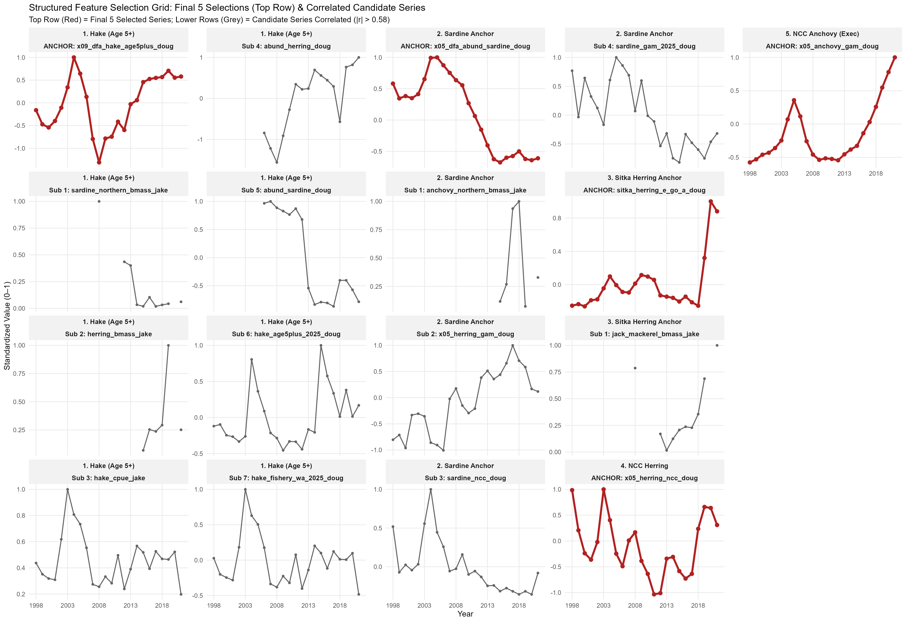
Selection of ocean indices – all hake and forage fish

Slide 38
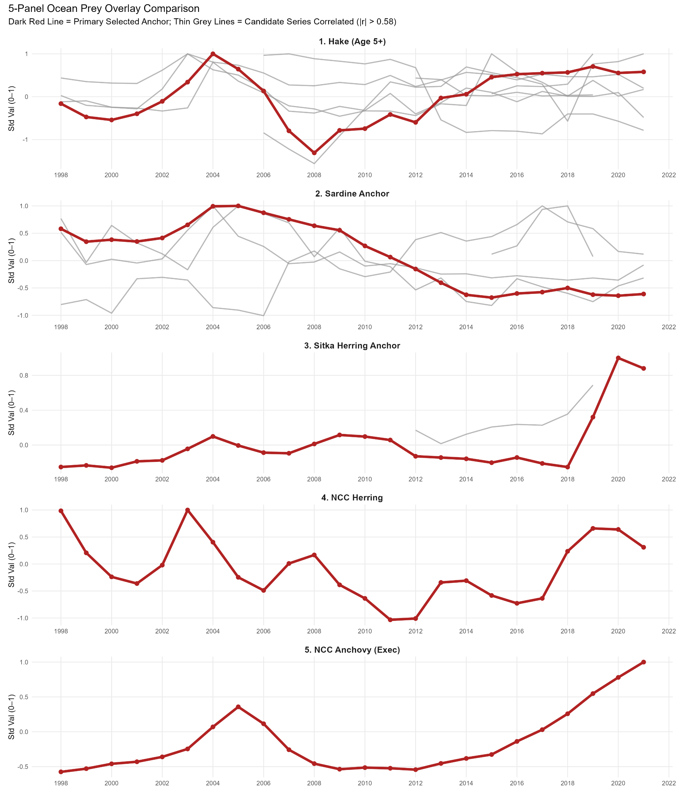
Ocean prey: Hake Sardine/herring Anchovy

Slide 39
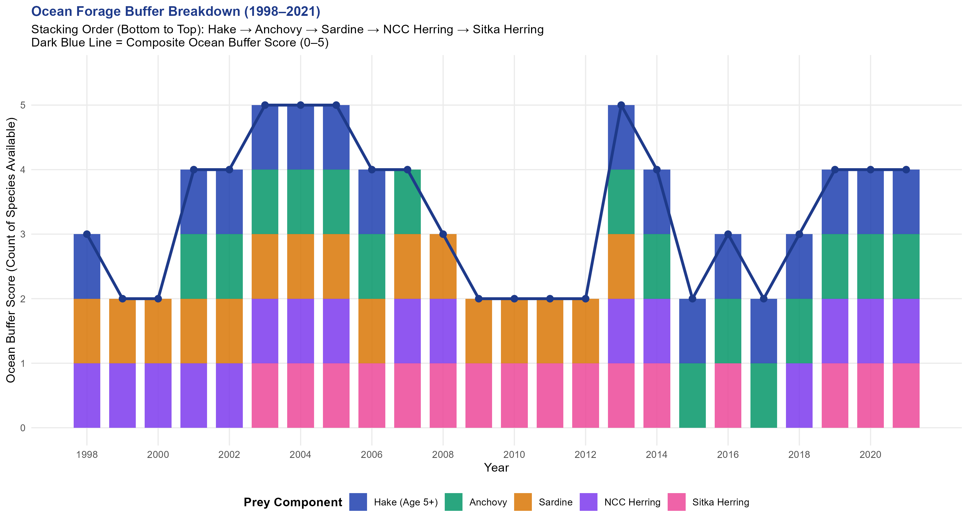

Slide 40
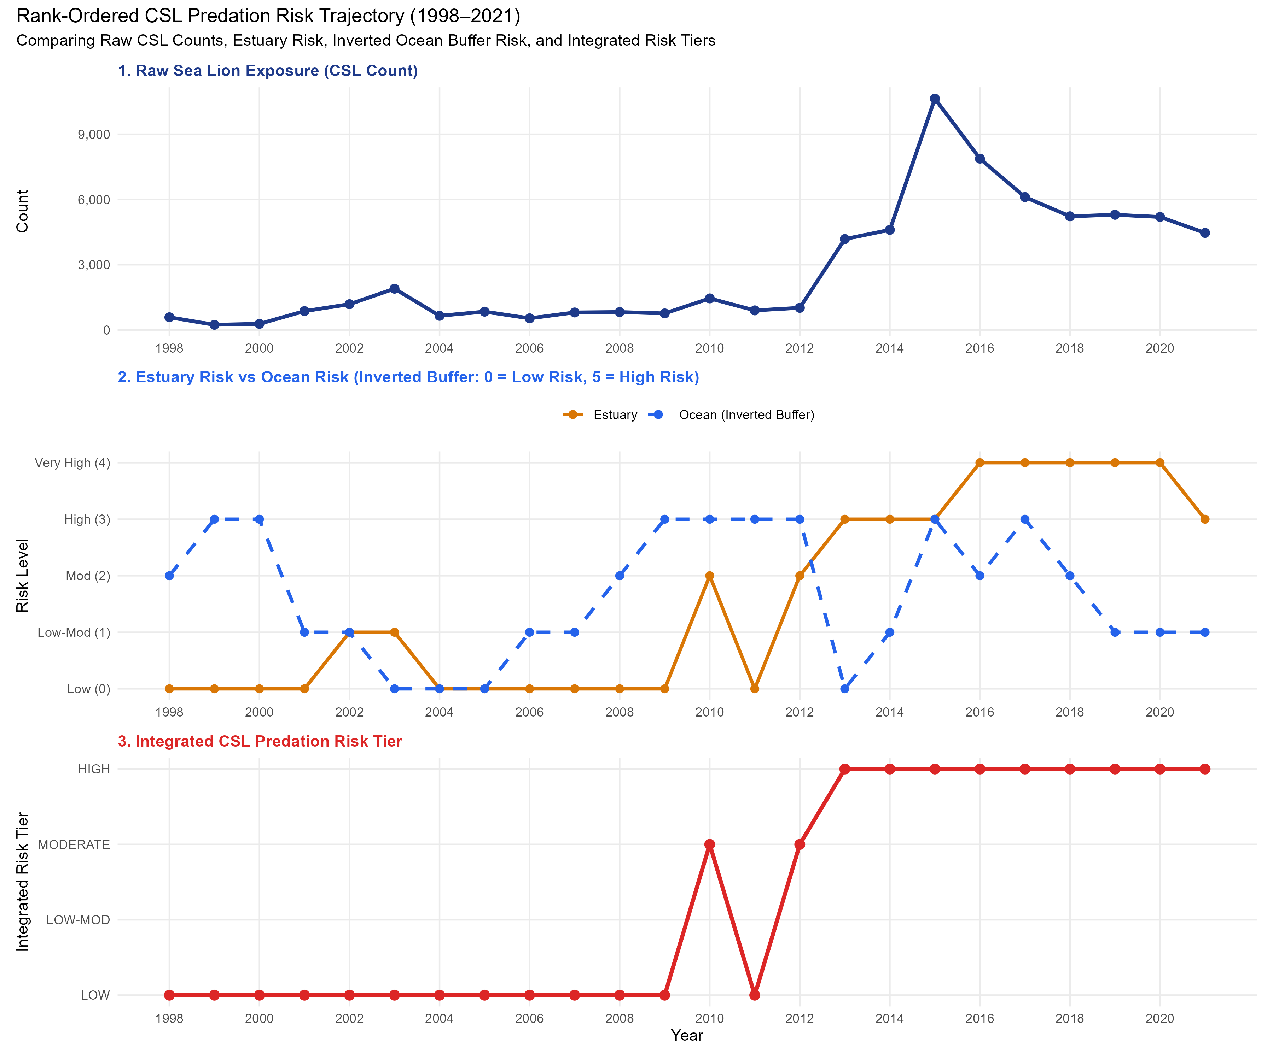
Estuary vs Ocean scores

Slide 41
Smolt year (by mistakie) With 2-yr lead for adult predator, had to drop ocean prey for now
# Candidate CSL indices (higher = higher predicted predation pressure)
d <- d %>%
mutate(
idx1_csl_only = csl_z,
idx2_csl_oceanrisk = csl_z + ocean_risk_z,
idx3_csl_minus_buffer = csl_z - ocean_buffer_z,
idx4_csl_buffer_mult = csl_z * (1 + ocean_risk_z),
idx5_csl_estuary_prey = csl_z - 0.5*eulachon_z - 0.5*shad_z,
idx6_full_quant = csl_z + ocean_risk_z - 0.5*eulachon_z - 0.5*shad_z,
idx7_with_ocean5 = csl_z - 0.5*ocean5_mean_z
)

Slide 42
With 2-yr lead for adult predator, had to drop ocean prey for now
# candidate risk indices
idxE1_csl_only_count = csl_z,
idxE2_csl_only_weekly = csl_week_z,
idxE3_csl_only_peak = csl_peak_z,
idxE4_csl_minus_buffer = safe_z(csl_z + est_risk_eul_heavy),
idxE5_csl_week_minus_buf = safe_z(csl_week_z + est_risk_eul_heavy),
idxE6_csl_peak_minus_buf = safe_z(csl_peak_z + est_risk_eul_heavy),
idxE7_mult_count = safe_z(csl_z * (1 + est_risk_eul_heavy)),
idxE8_mult_weekly = safe_z(csl_week_z * (1 + est_risk_eul_heavy)),
idxE9_mult_peak = safe_z(csl_peak_z * (1 + est_risk_eul_heavy)),
idxE10_csl_chinook_ratio = safe_z(log1p(csl_during_chinook) - log1p(chinook_estuary_total)),
idxE11_csl_eul_ratio = safe_z(log1p(csl_during_chinook) - log1p(eulachon_during_chinook + 1)),
idxE12_csl_shad_ratio = safe_z(log1p(csl_during_chinook) - log1p(shad_during_chinook + 1))
req_guild <- c(
"year","x07_dfa_cpue_int_spr_jun_hw","x09_dfa_hake_age5plus","x16_sar",
"x15_dfa_sleeper_shark_bsai_pred_ak","x15_issl_z"
)
csl_term | n | sar_r2 | aic | bic | cfi | rmsea | csl_est | csl_p | delta_r2_vs_base delta | _aic_vs_base
idxE10_csl_c… | 24 | 0.82 | 101 | 111 | 1 | 0 | -0.615 | 6.08E-05 | 0.119 | -10.3
idxE8_mult_w… | 24 | 0.762 | 108 | 119 | 0.999 | 0.0235 | -0.285 | 1.74E-02 | 0.0611 | -3.08
idxE2_csl_on… | 24 | 0.761 | 108 | 119 | 1 | 0 | -0.356 | 2.30E-02 | 0.0604 | -2.68
idxE11_csl_e… | 24 | 0.759 | 110 | 121 | 0.85 | 0.26 | -0.353 | 8.46E-02 | 0.0586 | -0.803
est_risk_eul… | 24 | 0.756 | 107 | 118 | 0.966 | 0.12 | 0.343 | 9.98E-03 | 0.0551 | -3.86
idxE1_csl_on… | 24 | 0.754 | 109 | 120 | 1 | 0 | -0.304 | 3.84E-02 | 0.0532 | -1.95
idxE7_mult_c… | 24 | 0.749 | 109 | 120 | 0.995 | 0.0425 | -0.242 | 4.55E-02 | 0.0486 | -1.7
idxE9_mult_p… | 24 | 0.73 | 111 | 121 | 0.983 | 0.0803 | -0.188 | 1.12E-01 | 0.0297 | -0.4
idxE3_csl_on… | 24 | 0.728 | 111 | 122 | 1 | 0 | -0.208 | 1.38E-01 | 0.0279 | -0.109
idxE12_csl_s… | 24 | 0.713 | 113 | 123 | 0.931 | 0.164 | -0.127 | 4.72E-01 | 0.0125 | 1.49
idxE6_csl_pe… | 24 | 0.702 | 113 | 123 | 0.938 | 0.155 | 0.102 | 5.04E-01 | 0.00117 | 1.56
BASE_NO_CSL | 24 | 0.7 | 111 | 121 | 0.962 | 0.14 | NA | NA | 0 | 0
1 idxE10_csl_chinook_ratio
2 idxE8_mult_weekly
3 idxE2_csl_only_weekly
4 idxE11_csl_eul_ratio
5 est_risk_eul_heavy
6 idxE1_csl_only_count
7 idxE7_mult_count
8 idxE9_mult_peak
9 idxE3_csl_only_peak
10 idxE12_csl_shad_ratio
11 idxE6_csl_peak_minus_buf
12 BASE_NO_CSL

Slide 43
Model selection with 2- and 3-variable models
model_type terms aic sar_r2
<chr> <chr> <dbl> <dbl>
1 3var_global x12_dfa_biomass_euph_shelf_sum + x15_arrowtooth_flounder_biomass_pred_ak + x15_pacific_cod_biom… 104. 0.789
2 3var_global x13_dfa_wgoa_dfa_seabirds + x15_issl_z + x15_ishark_df_asleeper_z 105. 0.780
3 3var_global x12_dfa_biomass_euph_shelf_sum + x15_issl_z + x15_ishark_df_asleeper_z 105. 0.779
4 3var_global x12_dfa_biomass_euph_shelf_sum + x13_ammod_wai + x13_hexagram_eai 105. 0.764
5 3var_global x12_dfa_biomass_euph_shelf_sum + x15_dfa_sleeper_shark_bsai_pred_ak + x15_issl_z 106. 0.778
model_type terms aic sar_r2
<chr> <chr> <dbl> <dbl>
1 2var_global x15_dfa_sleeper_shark_bsai_pred_ak + x15_issl_z 111. 0.700
2 2var_global x15_issl_z + x15_ishark_df_asleeper_z 114. 0.651
3 2var_global x13_ammod_wai + x15_issl_z 115. 0.595
4 2var_global x12_dfa_biomass_euph_shelf_sum + x15_ishark_df_asleeper_z 116. 0.623
5 2var_global x12_dfa_biomass_euph_shelf_sum + x13_ammod_wai 116. 0.587
model_type terms n aic bic cfi rmsea sar_r2 term1 term2 term3 b1 p1 b2 p2 b3 p3 n_terms has_ishark has_issl has_icsl
<chr> <chr> <int> <dbl> <dbl> <dbl> <dbl> <dbl> <chr> <chr> <chr> <dbl> <dbl> <dbl> <dbl> <dbl> <dbl> <int> <lgl> <lgl> <lgl>
1 2var_global x15_dfa_sleep… 24 111. 121. 0.962 0.140 0.700 x15_… x15_… NA -0.749 2.39e-7 -0.654 8.79e-6 NA NA 2 FALSE TRUE FALSE
2 2var_global x15_issl_z + … 24 114. 123. 0.936 0.175 0.651 x15_… x15_… NA -0.630 6.12e-5 -0.704 5.15e-6 NA NA 2 TRUE TRUE FALSE
3 2var_global x13_ammod_wai… 24 115. 125. 0.743 0.385 0.595 x13_… x15_… NA -0.634 1.71e-5 -0.535 3.82e-4 NA NA 2 FALSE TRUE FALSE
4 2var_global x12_dfa_bioma… 24 116. 125. 0.984 0.0823 0.623 x12_… x15_… NA -0.511 3.03e-4 -0.507 2.07e-4 NA NA 2 TRUE FALSE FALSE
5 2var_global x12_dfa_bioma… 24 116. 126. 0.843 0.277 0.587 x12_… x13_… NA -0.459 9.15e-4 -0.481 3.08e-4 NA NA 2 FALSE FALSE FALSE
model_type terms n aic bic cfi rmsea sar_r2 term1 term2 term3 b1 p1 b2 p2 b3 p3 n_terms has_ishark has_issl has_icsl has_any_index index_count model_label
<chr> <chr> <int> <dbl> <dbl> <dbl> <dbl> <dbl> <chr> <chr> <chr> <dbl> <dbl> <dbl> <dbl> <dbl> <dbl> <int> <lgl> <lgl> <lgl> <lgl> <int> <chr>
1 3var_global x12_dfa_biom… 24 104. 114. 1 0 0.789 x12_… x15_… x15_… -0.935 5.96e-12 -0.916 1.26e-10 0.763 5.05e- 8 3 FALSE FALSE FALSE FALSE 0 M3247
2 3var_global x13_dfa_wgoa… 24 105. 116. 1 0 0.780 x13_… x15_… x15_… -0.439 1.78e- 4 -0.765 3.89e- 9 -0.582 4.62e- 6 3 TRUE TRUE FALSE TRUE 2 M6221
3 3var_global x12_dfa_biom… 24 105. 116. 1 0 0.779 x12_… x15_… x15_… -0.414 1.86e- 4 -0.528 3.64e- 5 -0.789 2.60e-10 3 TRUE TRUE FALSE TRUE 2 M3330
4 3var_global x12_dfa_biom… 24 105. 116. 0.981 0.0929 0.764 x12_… x13_… x13_… -0.595 7.11e- 8 -0.460 6.16e- 6 -0.437 3.07e- 5 3 FALSE FALSE FALSE FALSE 0 M2742
5 3var_global x12_dfa_biom… 24 106. 116. 1 0 0.778 x12_… x15_… x15_… -0.324 3.45e- 3 -0.770 6.84e-10 -0.546 3.44e- 5 3 FALSE TRUE FALSE TRUE 1 M3322

Slide 44
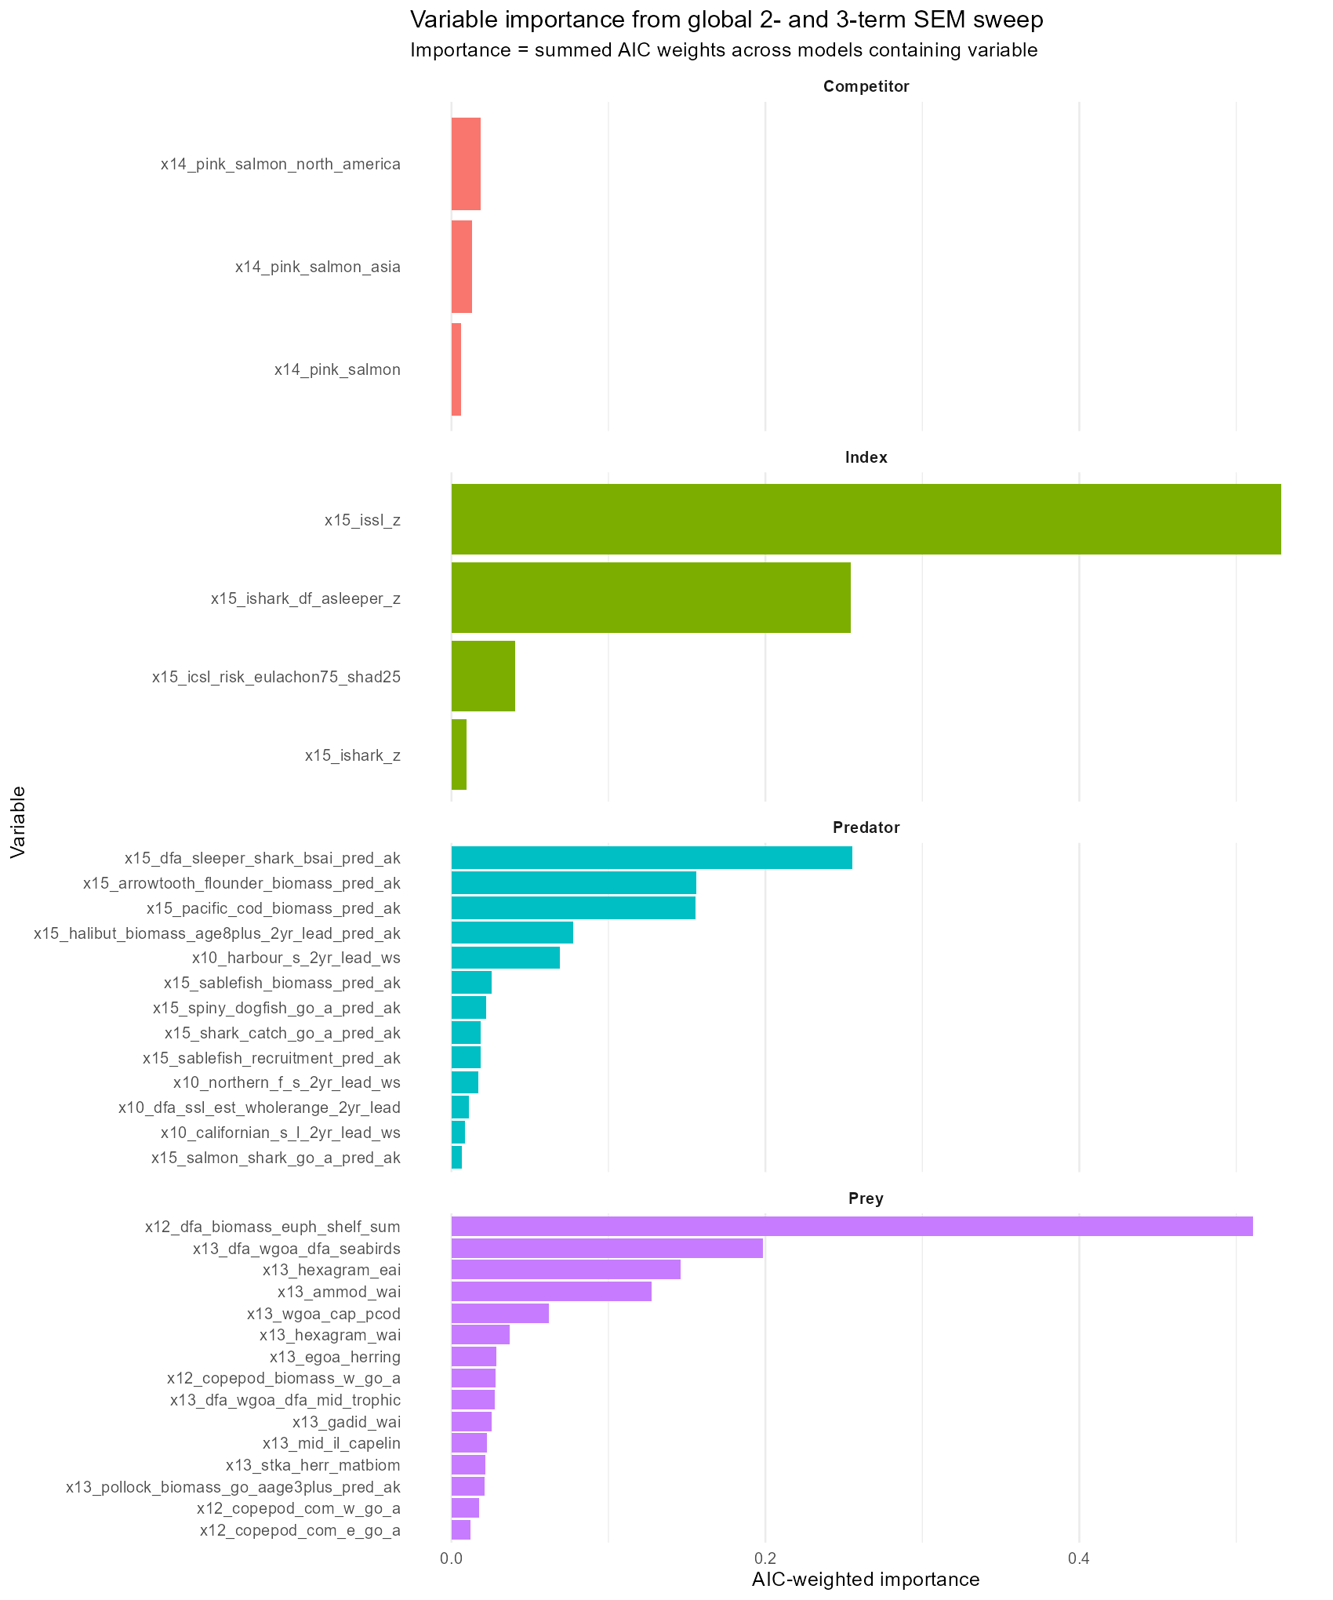
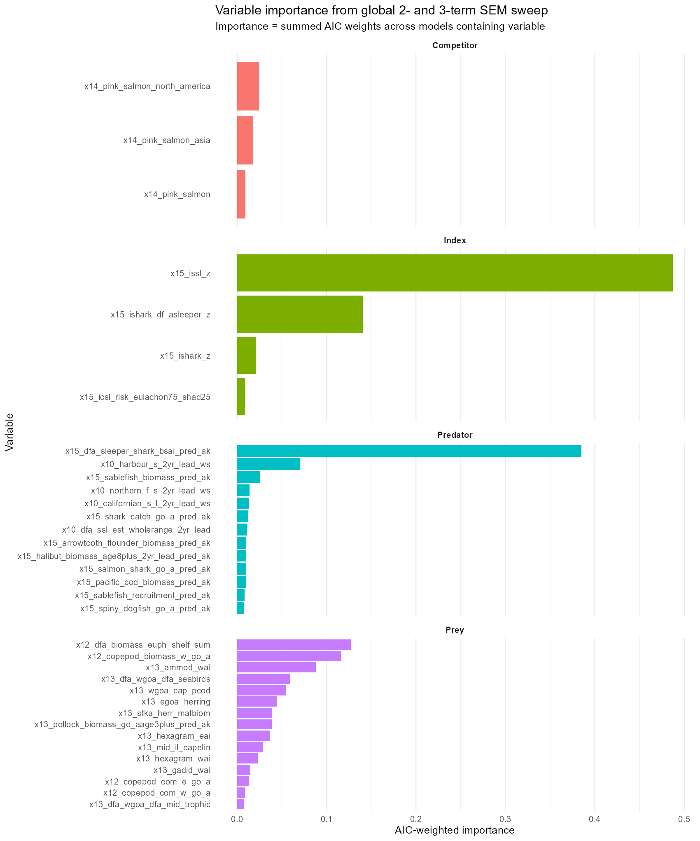
Model selection results
2-variable models, no climate

Slide 45
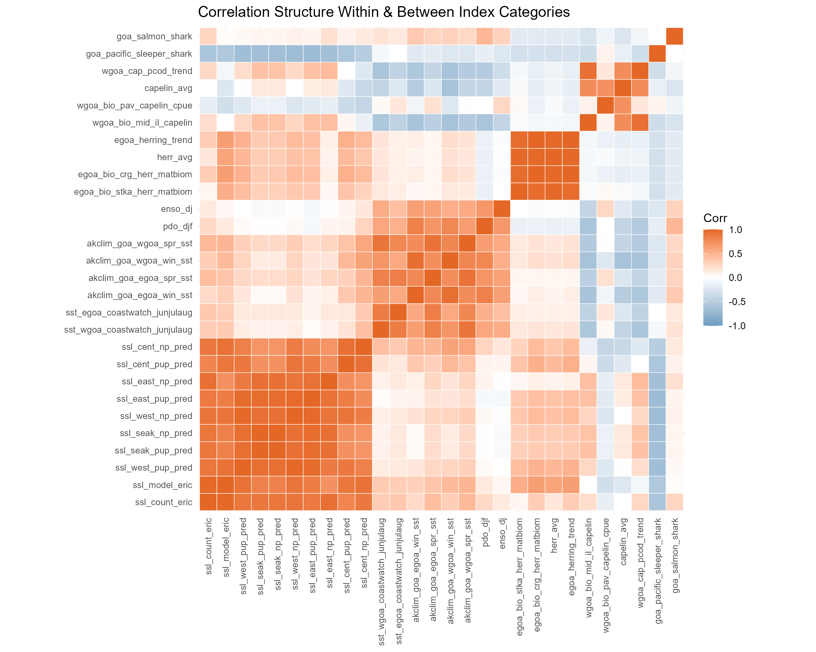
Sleeper and salmon sharks r=0
All ssl r>>0
2 herring r>>0
2 cap r ~ 0
Capelin and herring r<0
Pav cap v ssl r<0,
mid isl cap v ssl r>0
Sleeper v ssl r<0
All temp r>0, but
low for enso/pdo vs sst_coastwatch

Slide 46
It doesn’t matter which T driver I use for Mt

Slide 47
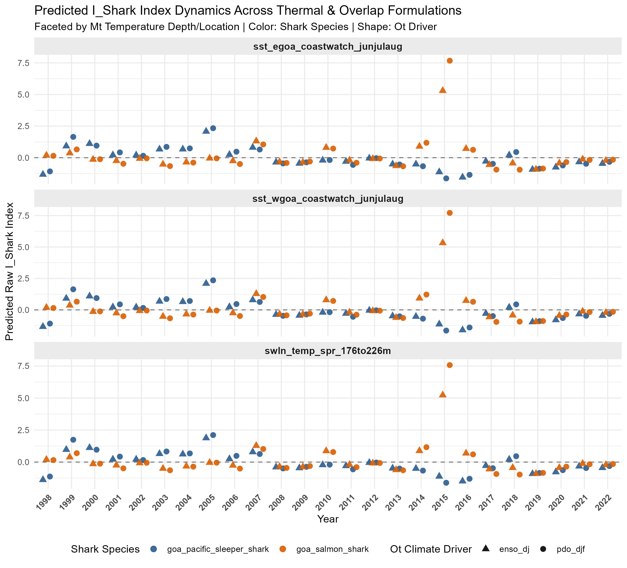

Slide 48
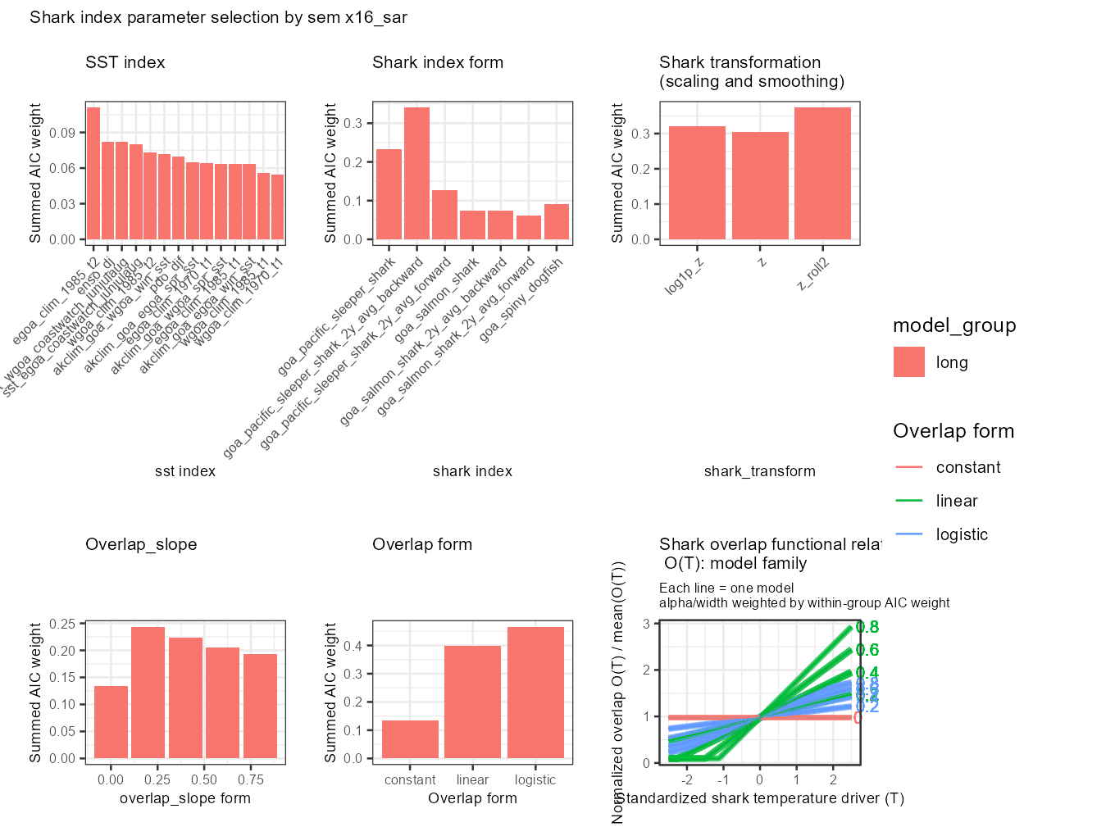

Slide 49
Sleeper shark index ~ enso should modify O_t to spatial T index (~HCI), and M_t to local T index
My_pred_03_shark_index_fxn.r

Slide 50
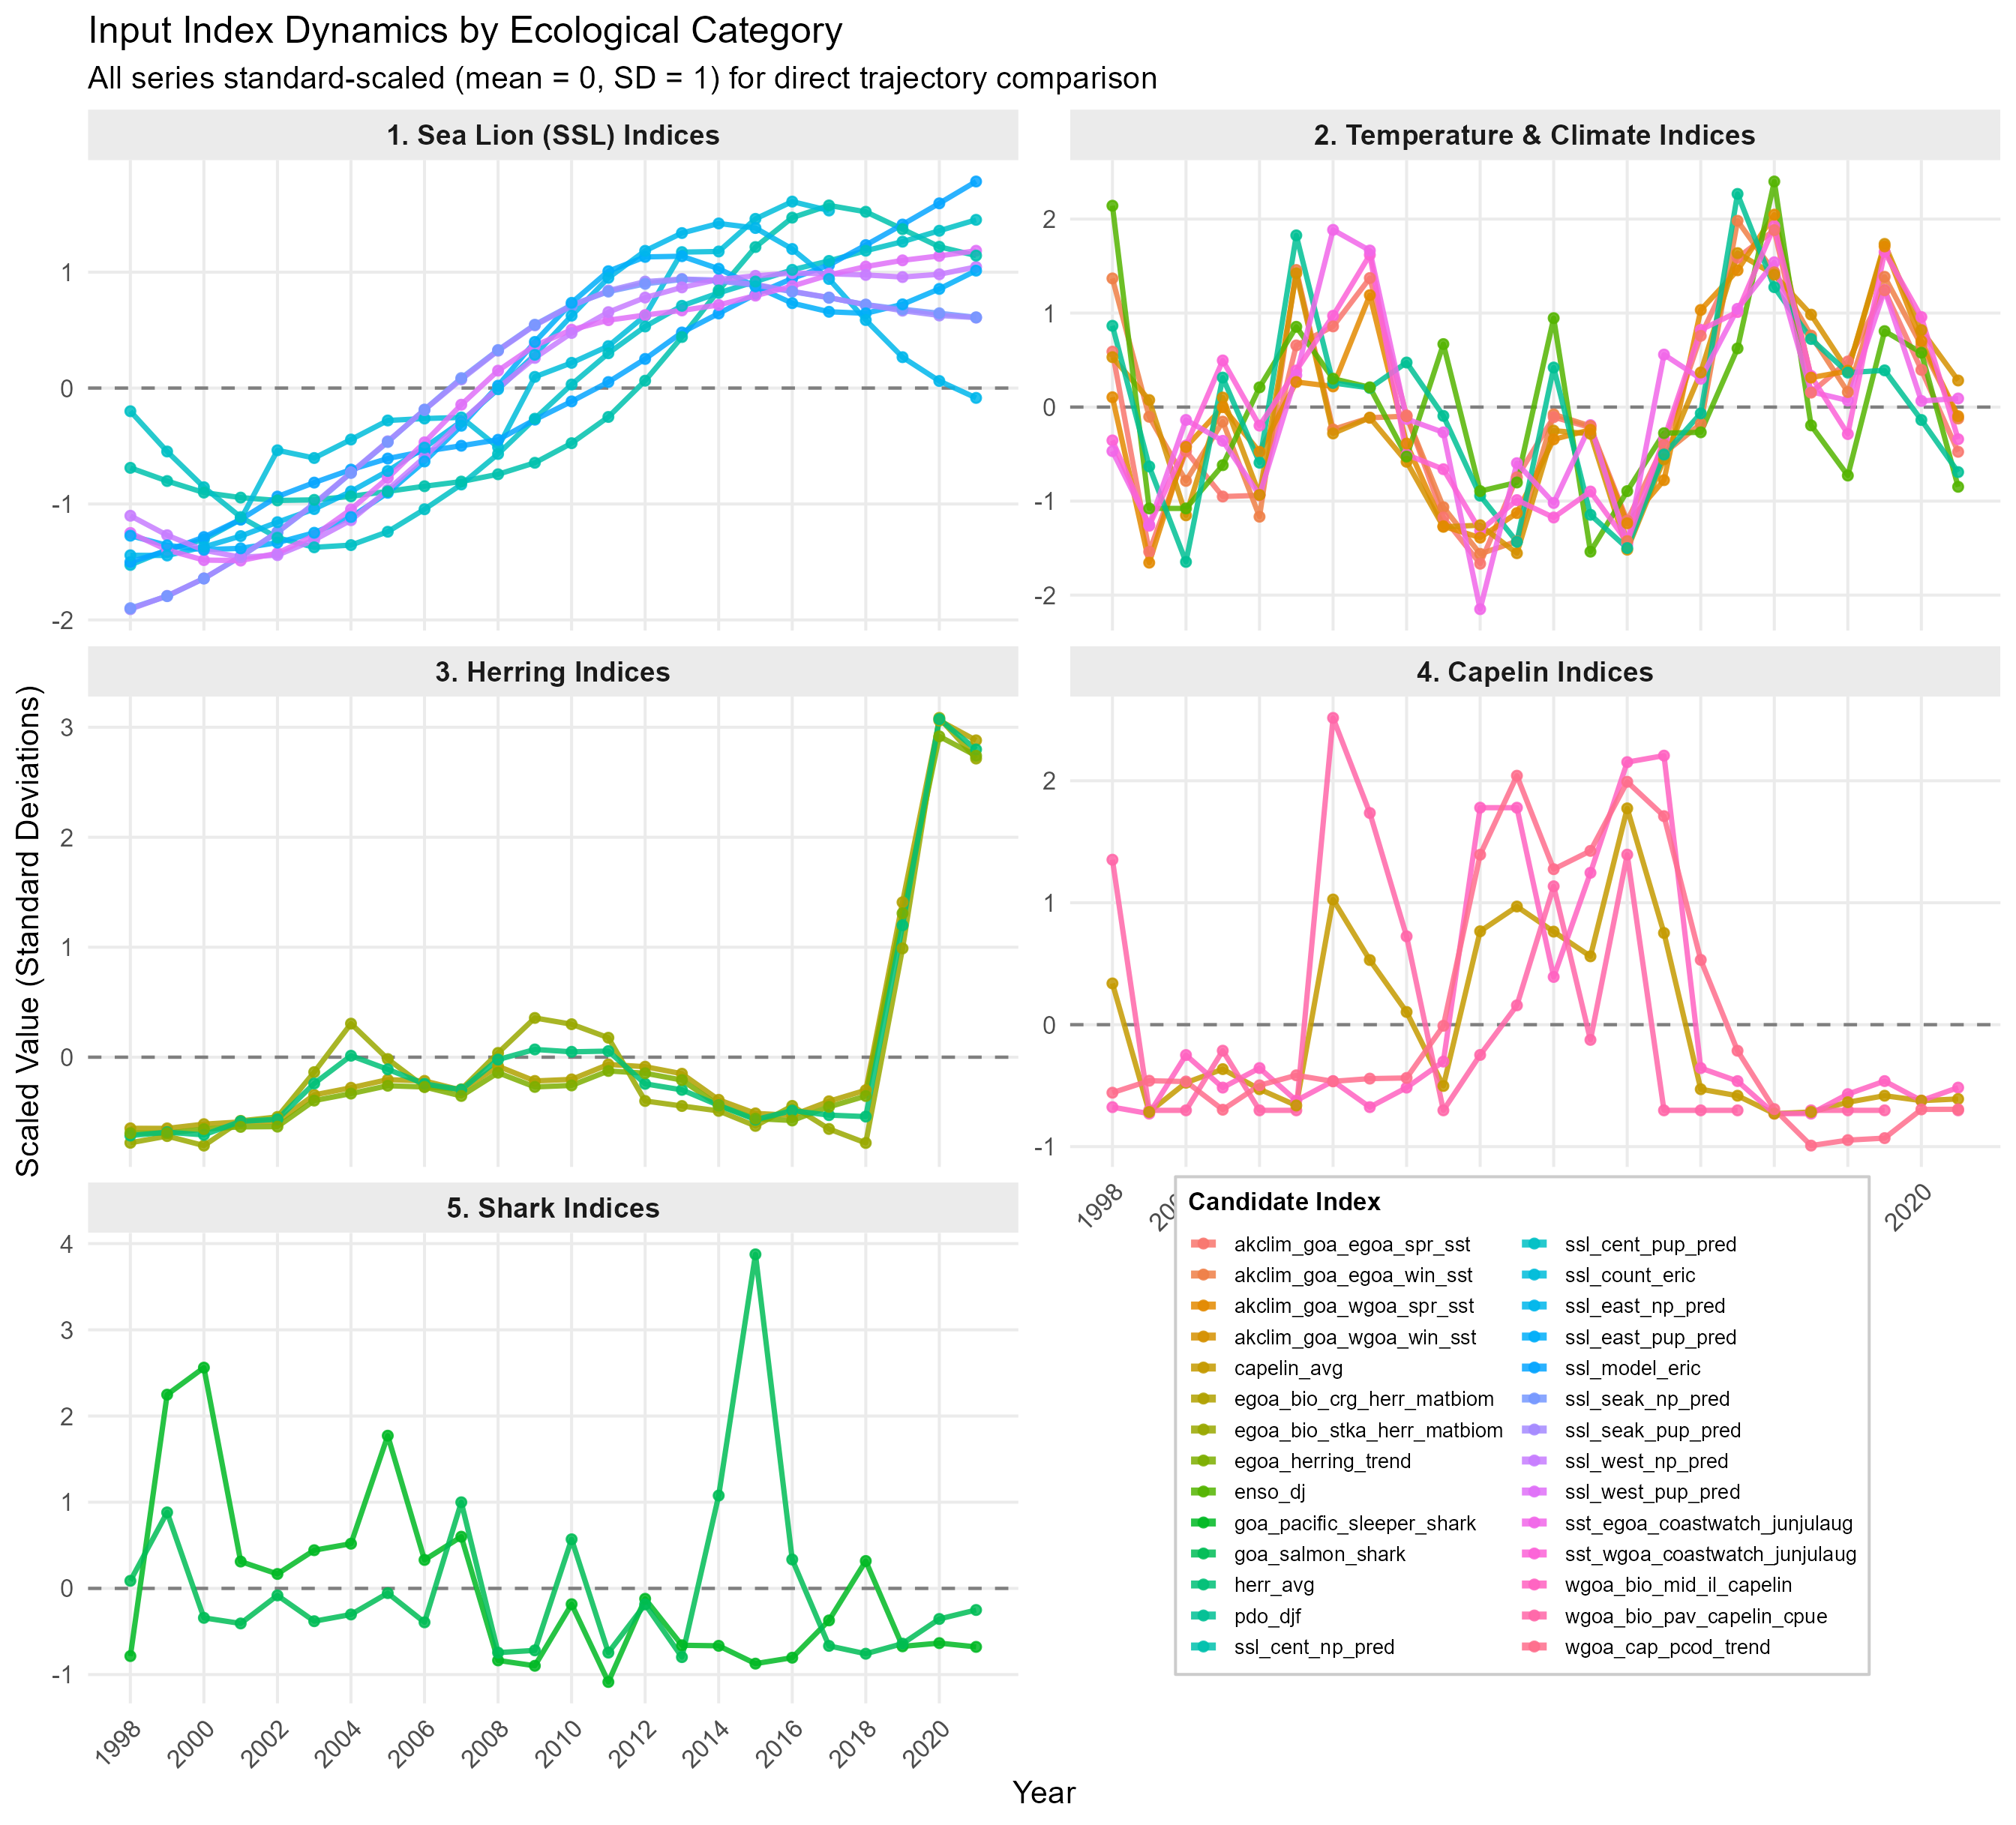

Slide 51
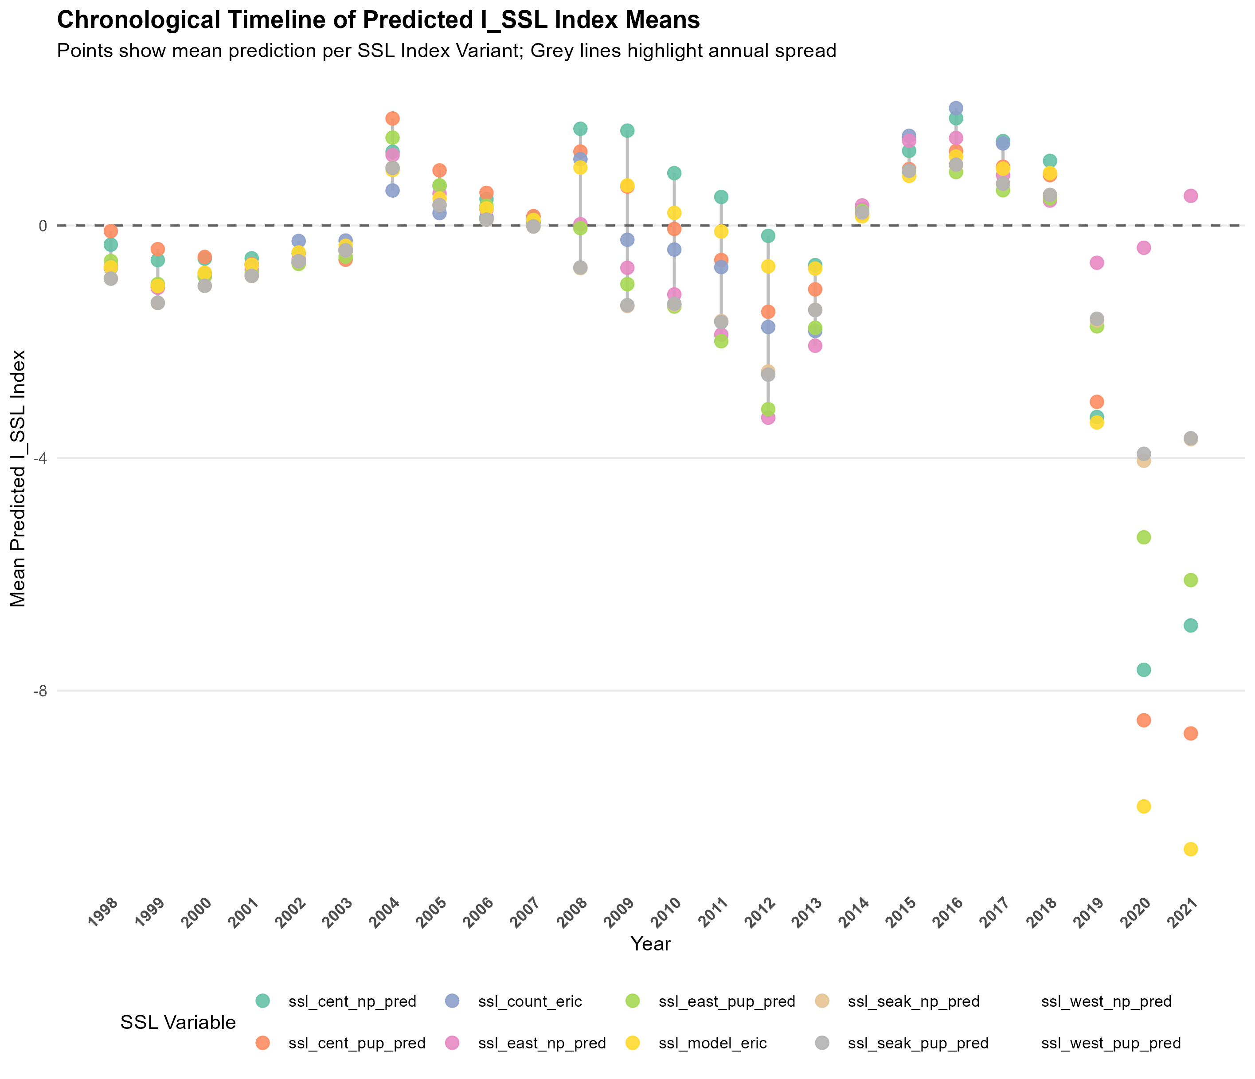

Slide 52
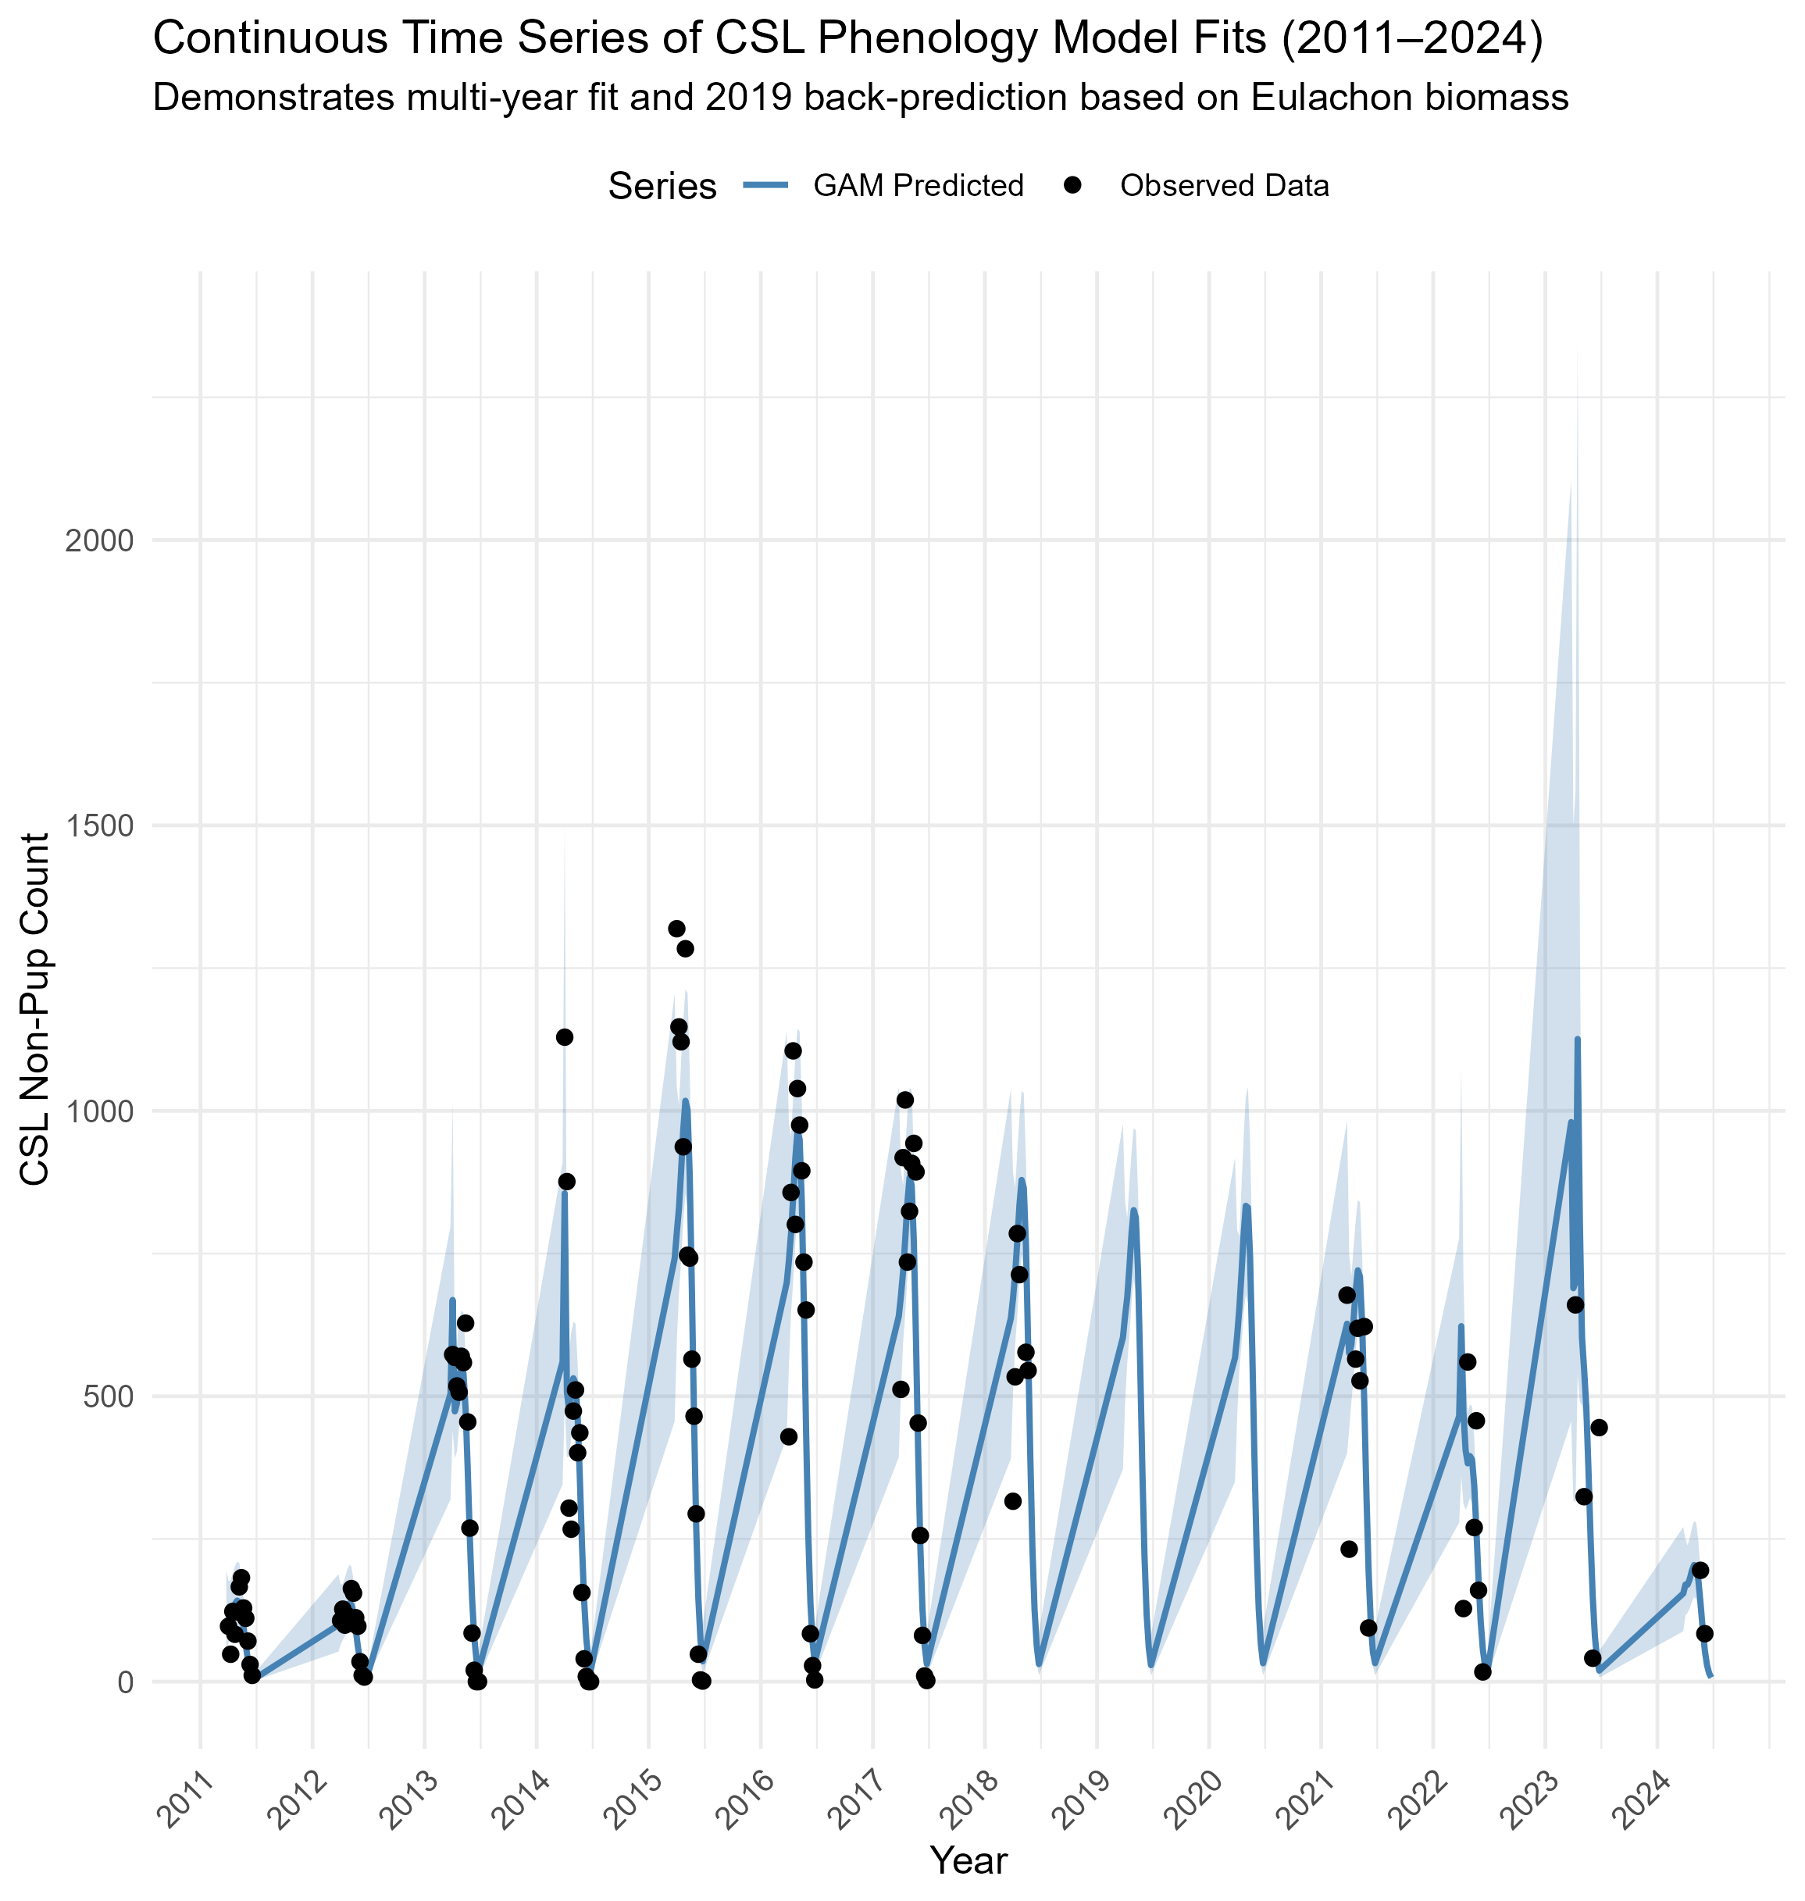
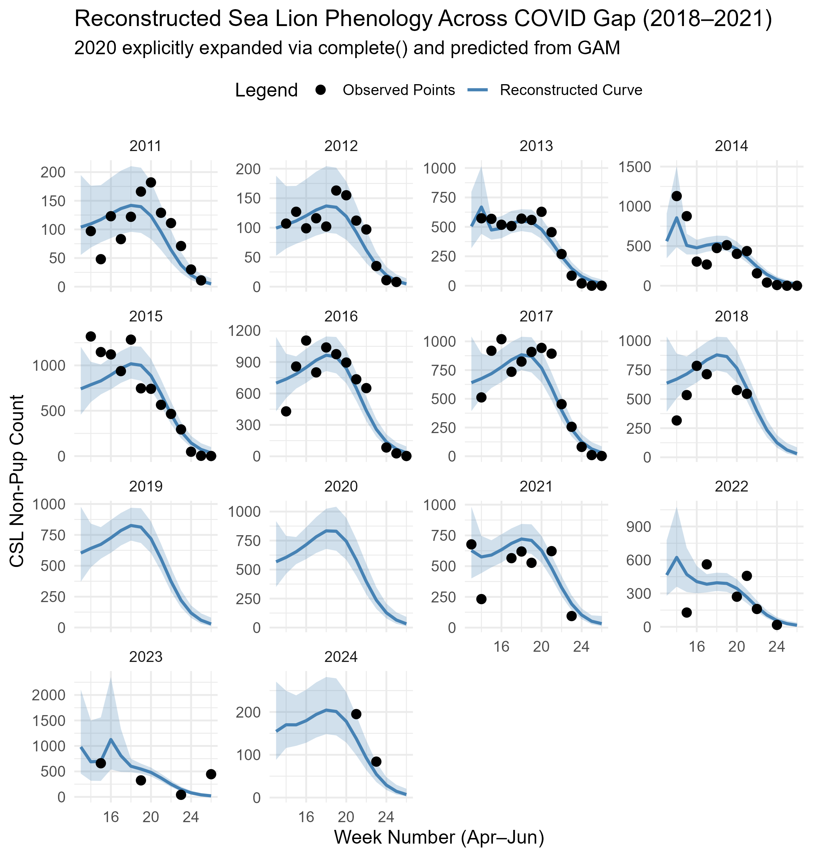
CSL Columbia River

Slide 53
Jake’s exposure metric
Ncsl*salmon_{biomass,week}/all prey_{biomass,week}
Main Methods
Collated abundance and biomass time series for 6 species (Table 1)
Converted prey abundance into biomass data (to standardize abundance indices) and plotted the biomass of each focal group at a weekly resolution from 2011-2024 (Figure 1)
Developed exposure metrics
Salmonid Proportion: Salmonid Proportion _{i} = (species _{i} biomass) / (total prey biomass) is the proportion that species i makes up of the total available prey biomass at a weekly temporal resolution (Figures 2 and 3). We developed individual Salmonid Proportions for each salmonid group in the Estuary and Bonneville
Salmon Exposure to Sea Lions (SESL): SESL _{i} = (Salmonid Proportion _{i}) * (pinniped count _{j}) combines this weekly salmonid proportion for species i with predator counts at location j to make a relative index of predation pressure on species i (Figure 3). Using proportion rather than raw abundance captures each group's dominance in the prey field when predators are foraging.
Averaged SESL by salmonid life stage and run (e.g. spring Chinook, summer Chinook, summer steelhead) for each year

Slide 54
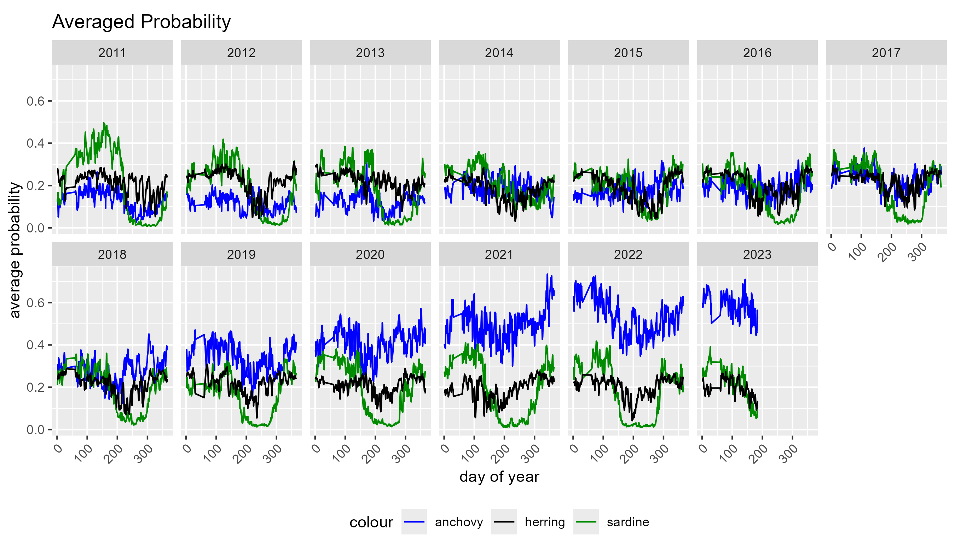
Forage fish daily prediction from Barb

